Slide 1
Development
An improvement in the quality of life

Slide 2
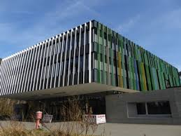
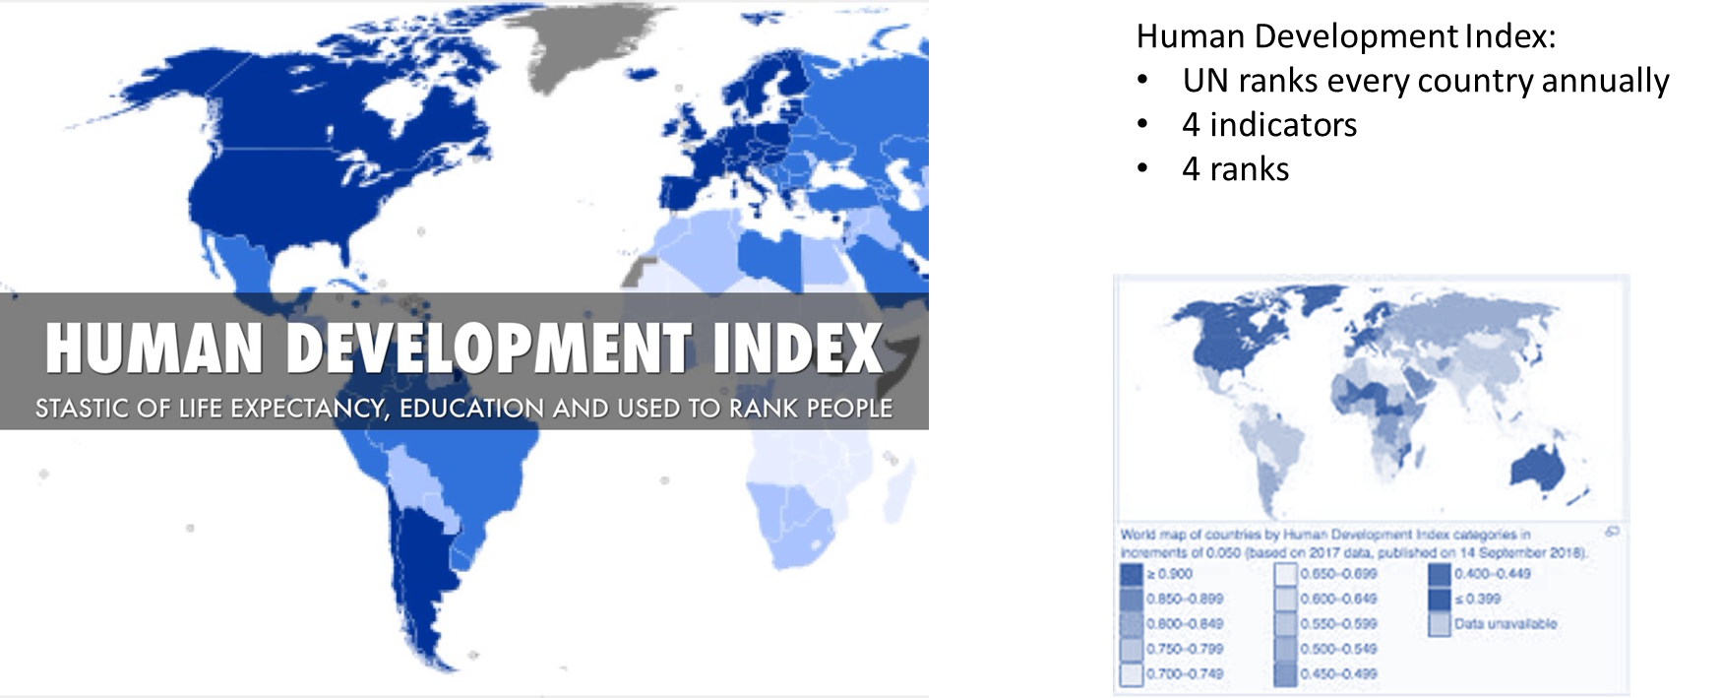
Use a Variety of Indicators to assess the Level of Development
Life expectancy:
End result of all of the factors contributing to a good quality of life
Differences are indicators of inequality
Main influences
Infant mortality
Gross National Product (GNP):
Traditional indicator of a country‘s wealth
Gross National Product per capita
Purchasing Power Parity
Problems with GNP
Literacy:
Important indicator of development
Other indicators....

Slide 3
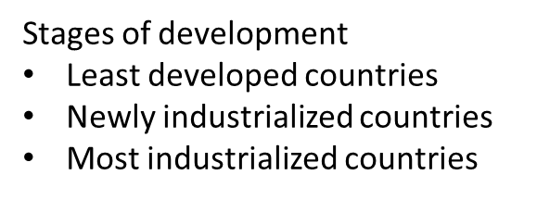
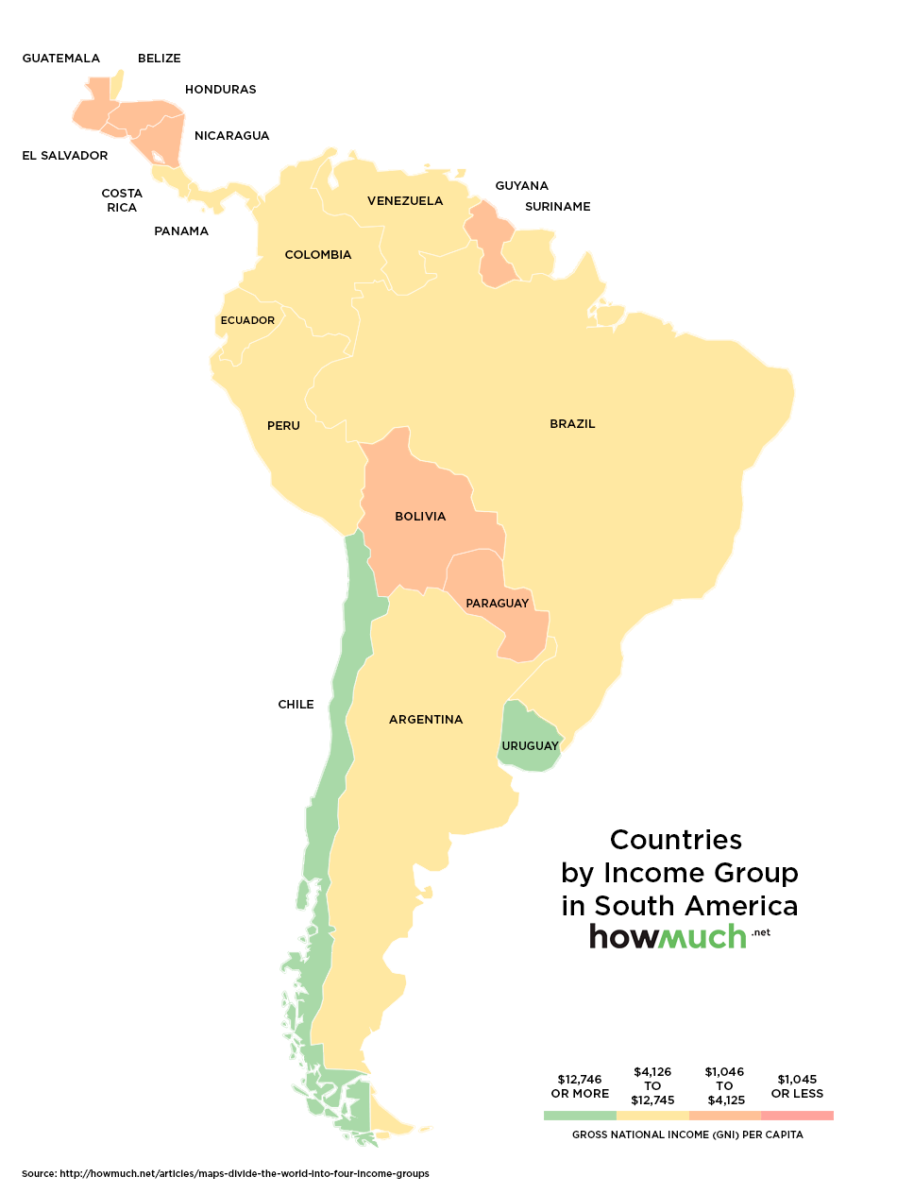
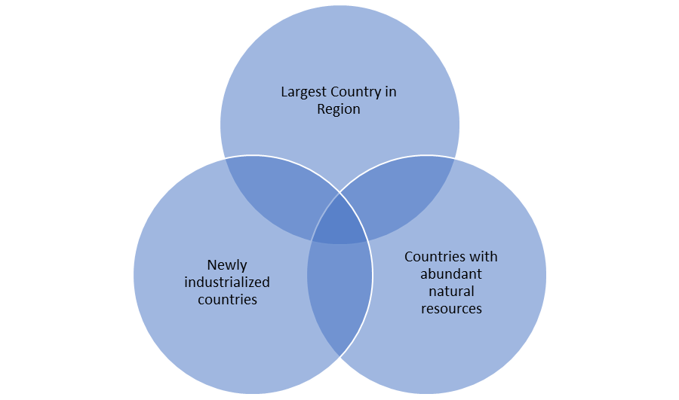
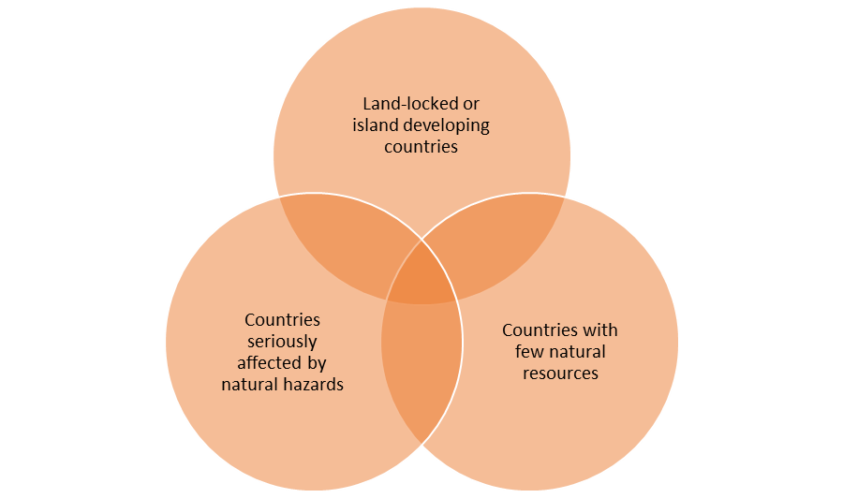
Explaining Inequalities between Countries
Explaining the development gap:
Physical factors
Economic factors
Demography
Consequences of the Development Gap
Consequences of poverty
a) Economic
b) Social
c) Environmental
d) Political

Slide 4
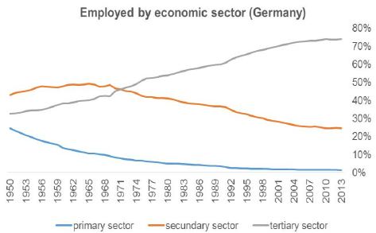
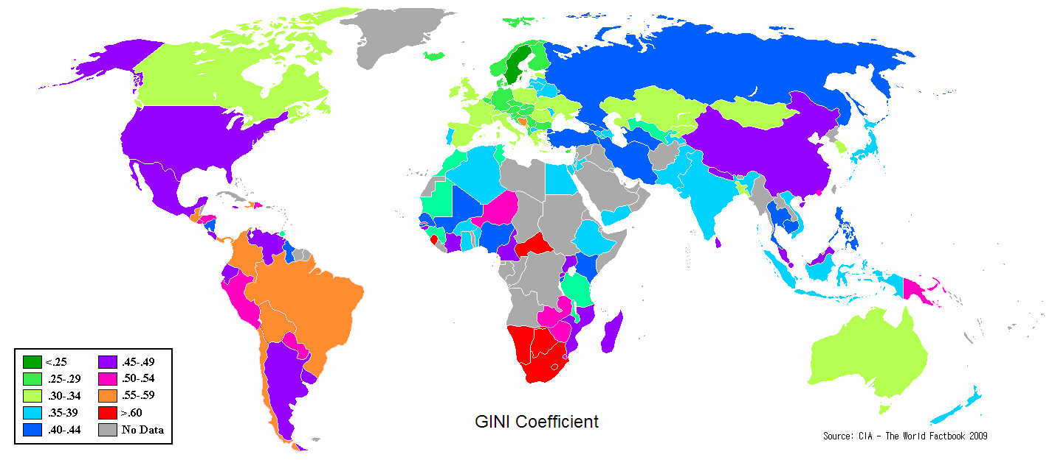
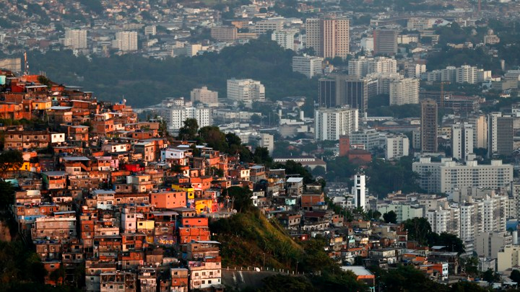
Explaining inequalities within countries
Factors affecting inequality within countries
Residence
Core and Periphery
Urban and rural
Intra-urban contrast
Differences between poorer and richer regions within urban areas.
Urbanization of poverty
The migration of poverty from rural to urban areas.
Ethnicity and employment
Institutionalised racism
Different amounts of pay for
Formal sector jobs
Informal sector jobs
Education
Different standards of education
Land ownership
Greatest disparities occur alongside greatest inequalities in land ownership
Classifying production into different economic sectors
– a method of sorting jobs
Gini coefficient - technique used to show income equality
{Values between 0 and 1.0}
The lower the value the more equal the income distribution.
The higher the value the less equal the income distribution.
A theory of regional disparities
Three stages of regional disparity:
Pre-industrial
Rapid economic growth
Regional economic convergence
Many developing countries have a high gini coefficient.
Primary sector
Working with materials
Secondary sector
Manufacturing primary materials into products
Tertiary sector
Provide services
Quaternary sector
Using high technology to provide expertise / working with research
How employment structure varies
As economies develop the proportion of people employed in each sector changes

Slide 5
Impacts
Negative Impacts
Positive Impacts
Globally
Changing world economic order due to the emergence of an increasing number of NIC
The international movement of workers due to migration to major global cities
Environmental degradation e.g.: air pollution, deforestation, desertification, landscapes, declines in diversity
Nationally
Conditions of developed nations improve and tose of poor nations will continue to worsen
Concerns about the loss of sovereignty to TNCs
a. (When a government loses political power and the ability to act autonomously)
b. Happens because TNCs employ an increasing share of the workforce
3) More cultural diversity can arrive in economically difficult condition
Locally:
Small businesses have found it hard to compete with major global companies
Closure of a TNC branch can cause high local unemployment
The populations of many local communities have become more multicultural
Increased international migration –families spread over more countries
Operates mostly in the interests of the richest countries
The role of LEDCs to provide cheap labour and raw materials
Abuse of LEDC laws
Threat to the world‘s cultural diversity
New jobs and skills for local people
Improved education, health and infrastructure
The sharing of ideas, experiences and lifestyles of people and cultures
Increases awareness of events

