Slide 1
Responding to Climate Change
Learning Objective: To be able to analyse how disparities in exposure to climate change risk and vulnerability differ ( including variations in people’s location, wealth, social differences (age, gender, education), risk perception).
Starter: What is Vulnerability?
Vulnerability-The susceptibility of a community to a hazard or to the impact of a hazard event.
Resilience-The capacity of individuals, societies, organisations or environments to recover and resume business as usual functions and operations following a hazard event or other system shock.
Challenge: Do you agree or disagree with these propositions?

Slide 2
Responding to Climate Change (Worksheet)
Characterisitcs of people and places that may affect vulnerability |  | How personal and societal perspectives might vary on the need to respond to climate change
Location and Vulnerability
Wealth, education and vulnerability
Age, gender and vulnerability
Risk percepetions and vulnerability

Slide 3
(Markscheme) Responding to Climate Change (Worksheet)

Slide 4
Comparative Case Study
Demo: Run a comparative review of the case studies, focusing specifically on Vunerability.
Learning Objective: To be able to analyse how disparities in exposure to climate change risk and vulnerability differ ( including variations in people’s location, wealth, social differences (age, gender, education), risk perception).
USA
Ethiopia

Slide 5
(Worksheet)Government-led adaption and mitigation strategies for global climate change
Adaptation
Mitigation

Slide 6
(Markscheme) Government-led adaption and mitigation strategies for global climate change
Challenge: What other mitigation or adaptation strategies do you know?

Slide 7
Mitigation

Slide 8
Government-led adaption and mitigation strategies for global climate change
Demo: What mitigation strategies do you know? Make a list.
?
13.1 Strengthen resilience and adaptive capacity to climate-related hazards and natural disasters in all countries
13.2 Integrate climate change measures into national policies, strategies and planning
13.3 Improve education, awareness-raising and human and institutional capacity on climate change mitigation, adaptation, impact reduction and early warning
13.A Implement the commitment undertaken by developed-country parties to the United Nations Framework Convention on Climate Change to a goal of mobilizing jointly $100 billion annually by 2020 from all sources to address the needs of developing countries in the context of meaningful mitigation actions and transparency on implementation and fully operationalize the Green Climate Fund through its capitalization as soon as possible
13.B Promote mechanisms for raising capacity for effective climate change-related planning and management in least developed countries and small island developing States, including focusing on women, youth and local and marginalized communities
*Acknowledging that the United Nations Framework Convention on Climate Change is the primary international, intergovernmental forum for negotiating the global response to climate change.

Slide 9
Plenary
Learning Objective: To be able to analyse how disparities in exposure to climate change risk and vulnerability differ ( including variations in people’s location, wealth, social differences (age, gender, education), risk perception).
Plenary: Have we been able to complete the learning objective above? Review the progress that we have made.
Homework: Note down the link below and create a timeline with what you believe to be significant. This is important for your essay work that you might receive in paper 2. Due 12th March 2018
Homework
http://unfccc.int/timeline

Slide 10
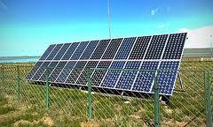
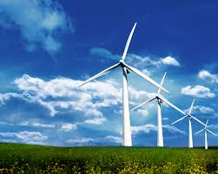
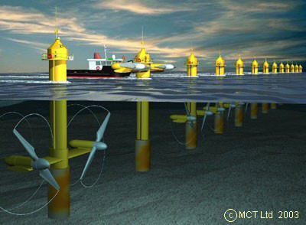
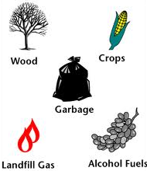
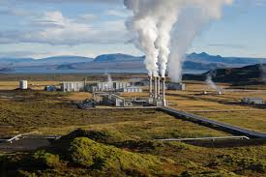
Renewables
Renewable energy is energy that comes from resources which are continually replenished such as sunlight, wind, rain, tides, waves, and geothermal heat.
Wind Farm
Solar Power
Biomass
Demo: Write a definition of renewable energy in your own words.
Describe 3 main types
Tidal Barrage
Challenge: Explain which energy source you think is best and why. Use P.E.E.S
Geothermal Plant

Slide 11
Combating Climate Change
Demo:
Study the table. For each sector, choose one current and one future response and explain what the point of using it would be.
Sector | Currently Available | Available by 2030
Energy Supply | Improved supply and distribution efficiency; switching from coal to gas; nuclear power; renewable energy | Carbon Capture and storage (to replace fossil fuels); advanced nuclear energy
Transport | Higher fuel efficiency; Hybrid cars; biofuels; public transport; bicycles | More powerful electric cars
Industry | Heat and power recovery; recycling; use of different materials; control of emissions (carbon quotas) | Technological changes in manufacturing processes
Agriculture | Land management to increase carbon storage; dedicated ‘energy’’ crops to replace fossil fuels | Improvement in crop yields; reduction in emissions from agricultural practices
Forests | Afforestation; forestry waste for Bio-energy | Tree-science to increase carbon capture

