Slide 1
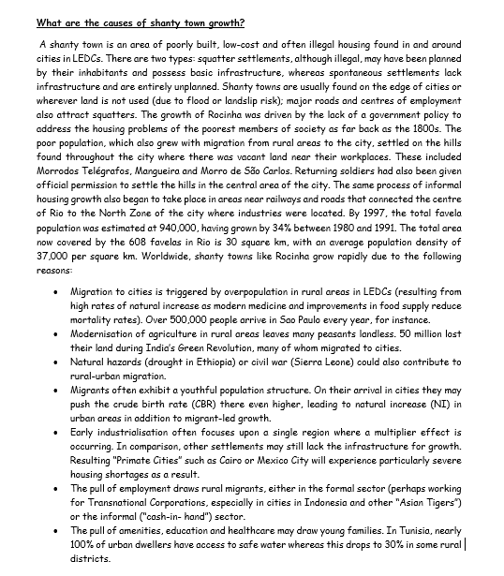
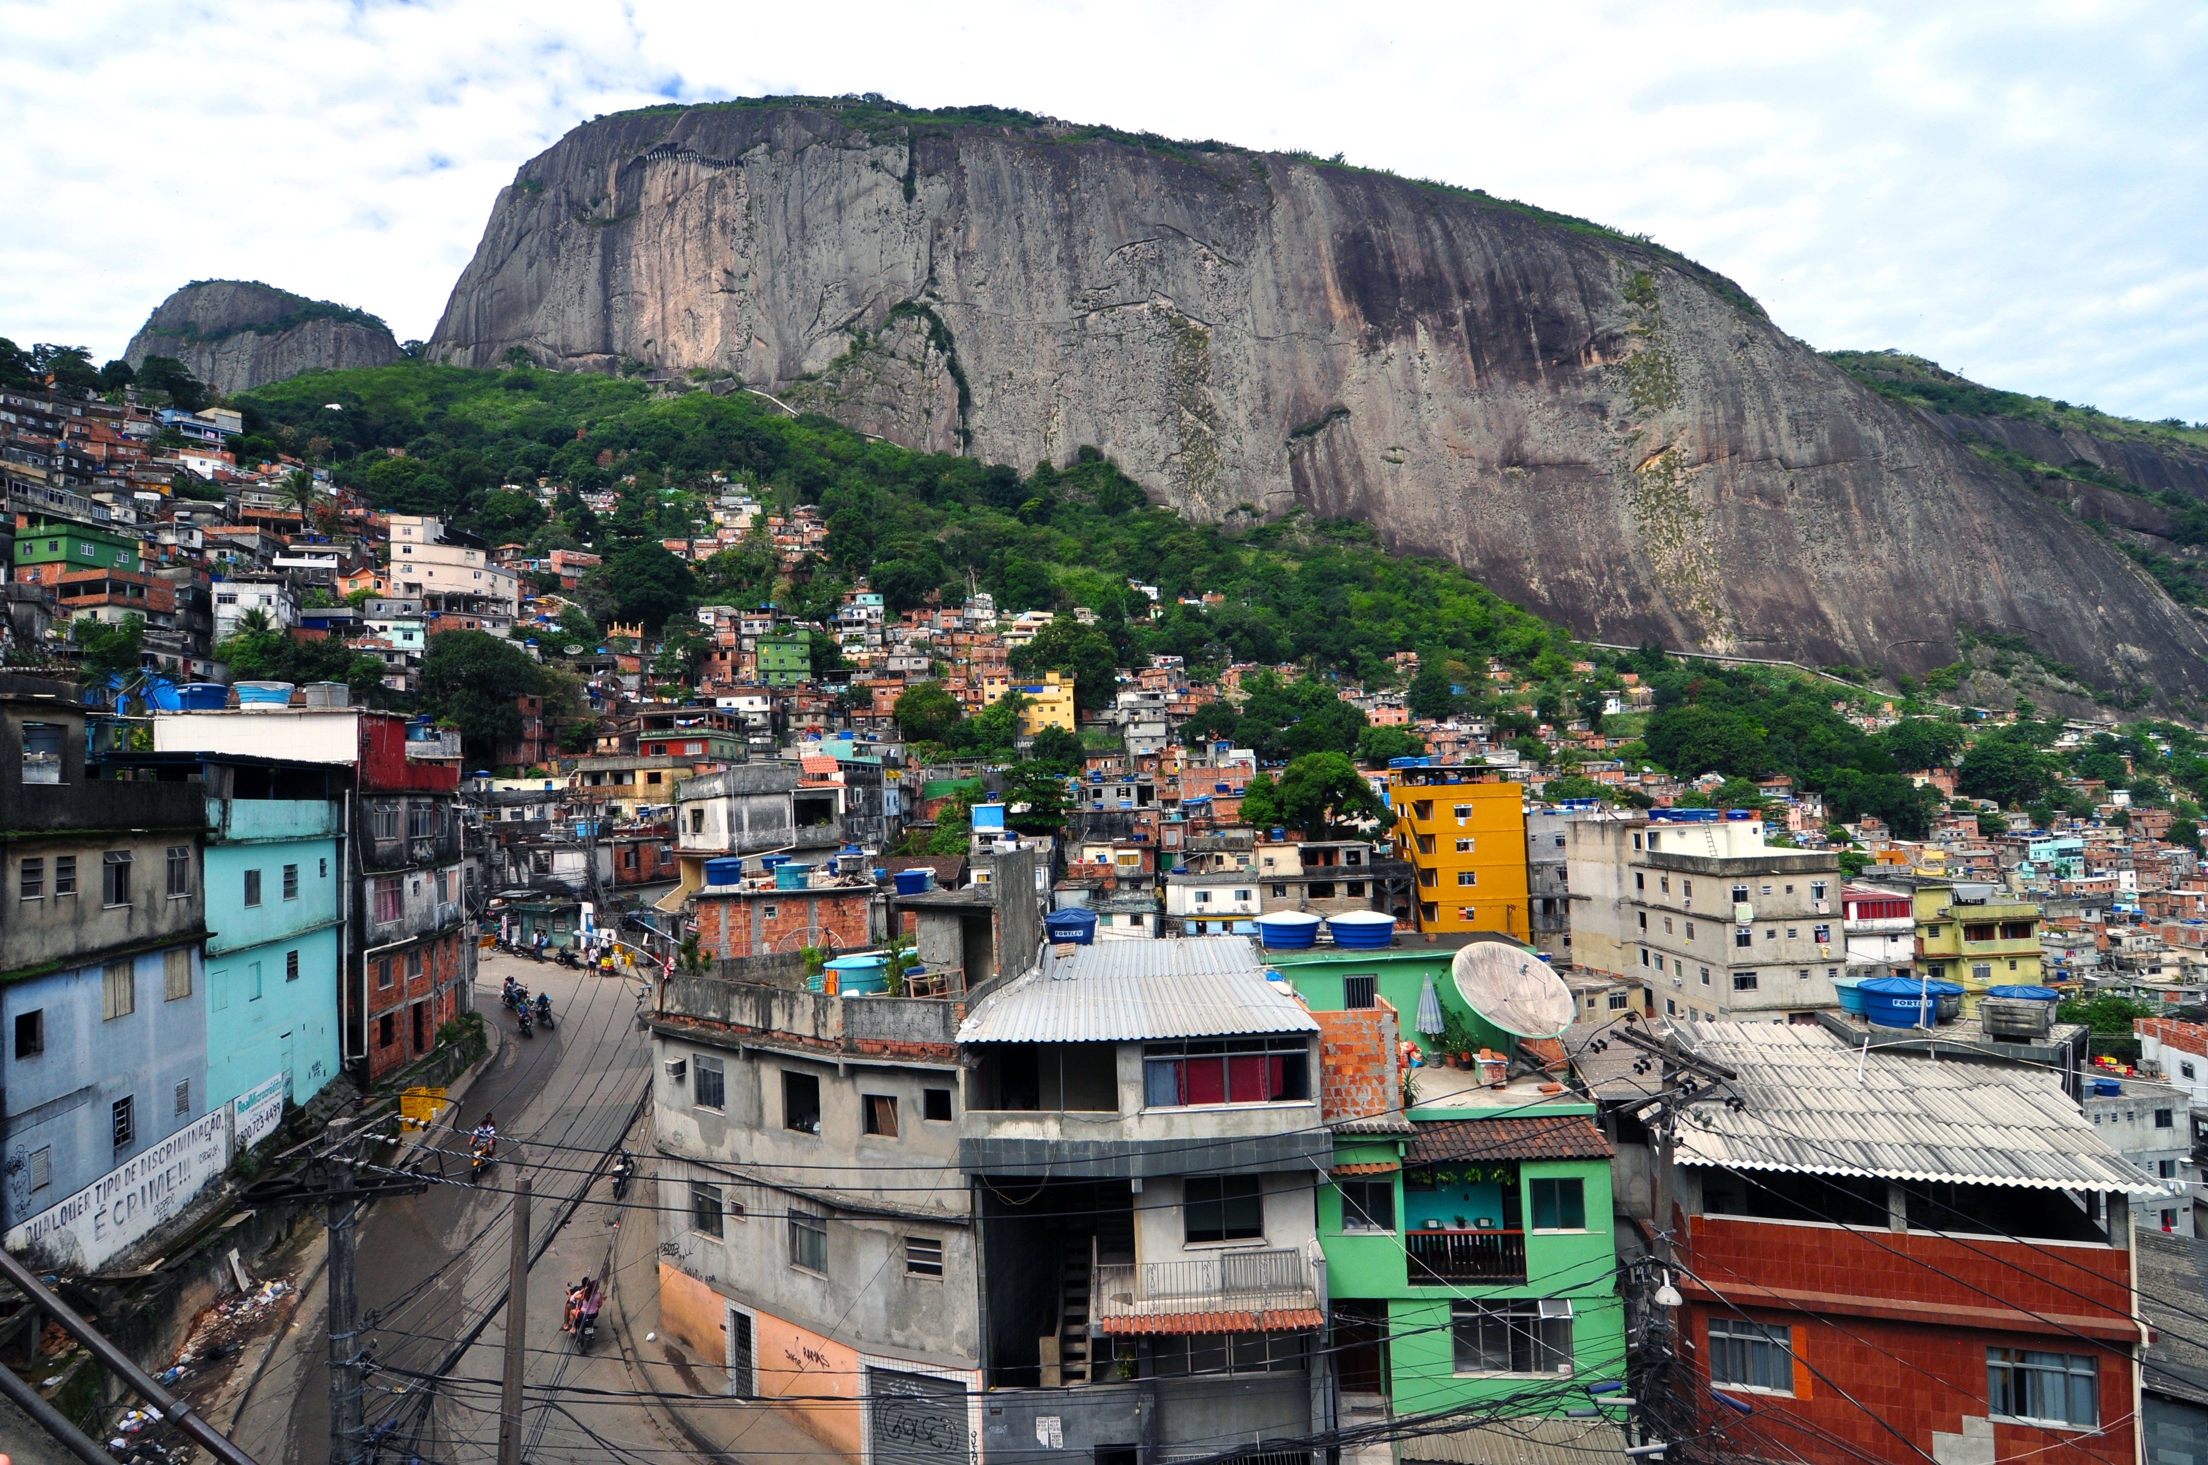
URBANISATION IN BRAZIL - RIO DE JANEIRO
Learning Objective:To find out why people move to Rio de Janeiro in huge numbers and the impacts that this has on the megacity.
Starter: Read the sheet and define a shanty town and explain the two different types that exist
Reading

Slide 2
Exam Question: You are going to answer the following IGCSE question: “For a named city in an NIC that you have studied, describe attempts to improve the quality of life there” (7)
Problems found for Rocinha | Solutions found for Rocinha

Slide 3
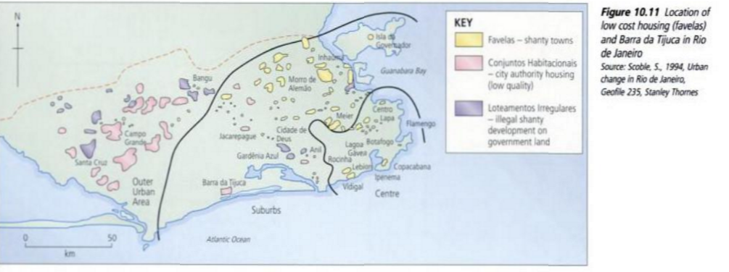
Urban Managment-Solutions

Slide 4
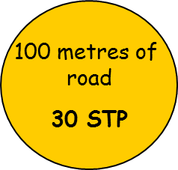
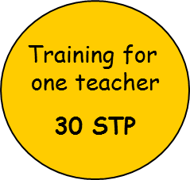
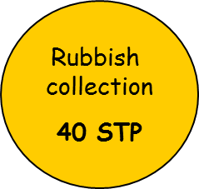

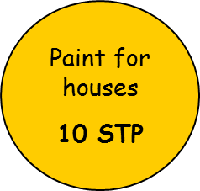

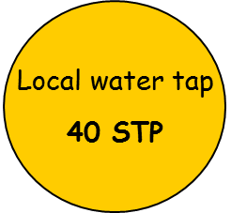
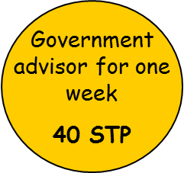
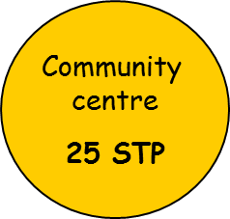

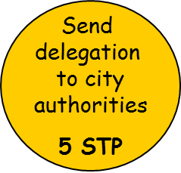

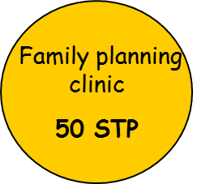
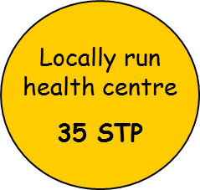
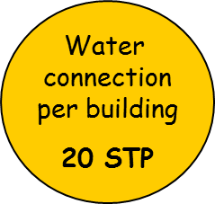
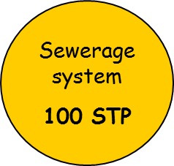
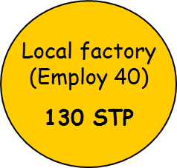


Decision Making Activity
Plenary: Solving the Problems: Now you have ranked the problems in shanty towns you are going to create a plan to improve them. You have 200 STP (Shanty Town Pounds) to spend in your first year and another 200 in your second year. Complete the sheet using the information below.

