Slide 1
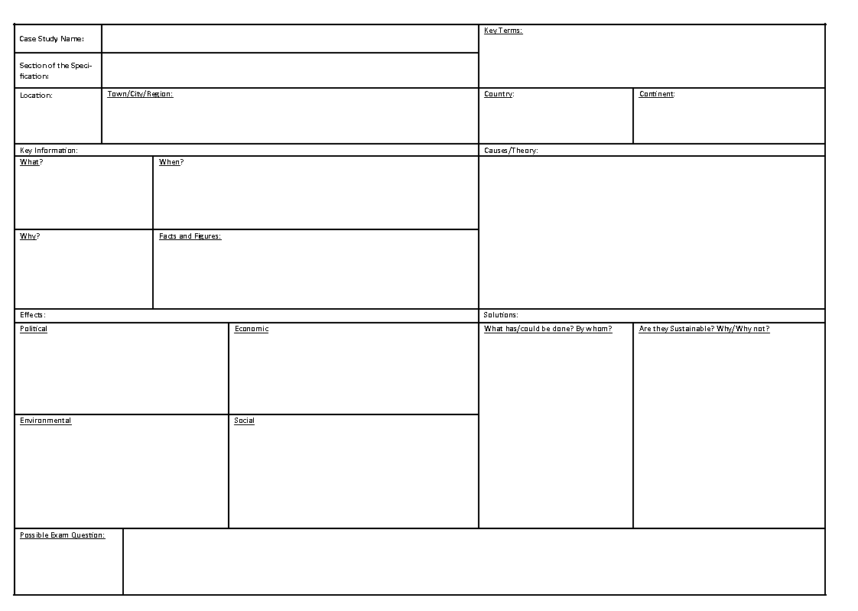
Case Study(Regional Contrasts in Brazil)
Learning Objective: What is the influence on disparities and inequalities of ethnicity, residence, parental education, income, employment (formal and informal) and land ownership.
Starter: Read through your information sheet and fill in your Case Study sheet.

