Slide 3
Changing Identities and Culture
Learning Objective:
Starter: Read the Sheet and decide which of the definitions is most appropriate for you. Ensure to be able to justify your answer.
Past Exam Question:
To what extent does global culture exist? Discuss this statement.

Slide 4
Cultural diffusion: the process
Learning Objective:
Starter: What is Culture?
Culture: the total of the inherited ideas, beliefs, values and knowledge which constitute the shared basis of social action.
"Values in a culture are not selected arbitrarily, but invariably reflect an underlying system of beliefs. . . "At the very heart of any culture is its world view. . . Sometimes people who share the gospel cross-culturally fail to take the problem of world view into account and are therefore disappointed by the lack of genuine change their efforts produce."
Kwast’s model of culture

Slide 5
Road to Success
Learning Objective : Describe global spectrum of cultural traits, ethnicities and identities, and ways in which the spectrum of diversity is widening or narrowing at different scales.
Key Terms
Culture: the total of the inherited ideas, beliefs, values and knowledge which constitute the shared basis of social action. Cultural traits: individual components of a cultural complex which may be divided into three categories: sociological, ideological and technological. Cultural hearth: an area that is or has been a rich source of cultural traits. Cultural hybridity: the extent to which cultures are intermixed. Official language: the language of a country, region or institution that is embedded in law. Bilingual country: a country in which two languages are commonly spoken. Ethnicity-the fact or state of belonging to a social group that has a common national or cultural tradition. Identity- Who you are, the way you think about yourself, the way you are viewed by the world and the characteristics. | Separatist movements: political parties or other organisations which believe that their region should separate from its current country to form a new country. Customs: the established patterns of behaviour that are commonplace within a particular country, region or social setting. Secularism: a view that rejects religion and religious considerations. Stereotype: a standardised mental picture that is held in common by members of a group and that represents an oversimplified opinion, prejudiced attitude or uncritical judgement. Cultural diffusion: the process of the spreading of cultural traits from one place to another. Cultural or creative industries: industries that involve the spreading or creating of culture.

Slide 6
Changes in diversity
Diversity is widening
Diversity is narrowing
Case Study
Syria
Afghanistan
Conflict
Urbanization
Case Study
Clone Towns
Case Study
Mexico- USA (Global)
Brazil (internal migration)-XINGU PEOPLE
Migration
Case Study
Globalization
Americanization
Education
Westernization
Equality
Case Study
English Language
Case Study
BRIC Nations
Language
Greater Development
TNC’s
Physical Barrier
Case Study
Apple
Facebook
Ikea
Gender Inequality
Political Ideology/Trade Blocs
Case Study
EU/NAFTA
Climate Change
Case Study
Capitalism
Global Identity

Slide 7
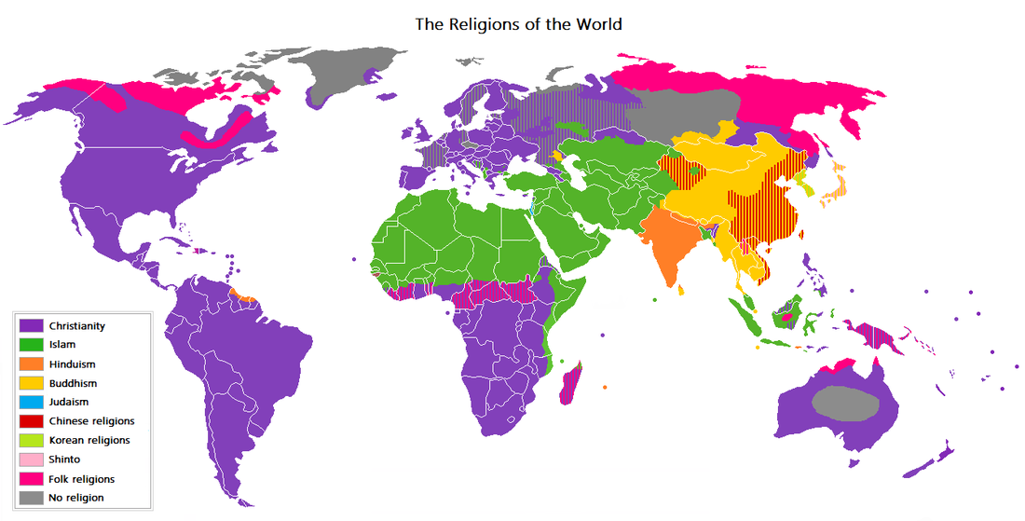
Customs
Belief
Customs: These are common patterns of behaviour found with particular countries or regions that are then passed down through generations. Examples may include bowing to elders, not tipping, taking of shoes inside houses and celebrating certain days e.g. St. Patrick's (Paddy's) Day.
Beliefs: There are five major religions in the World i.e. Islam, Christianity, Buddhism, Hinduism, Judaism and Taoism. Out of these probably only Islam and Christianity can be regarded as truly global
Demo: Describe the distribution of belief using Fig. 1
Challenge: What links Food and Belief together?
Learning Objective : Describe cultural traits in terms of language, customs, beliefs, dress, images, music, food and technology. To examine the diffusion of cultural traits resulting from the international movement of workers and tourists and commodities.
dress
technology
images
food
music

Slide 8
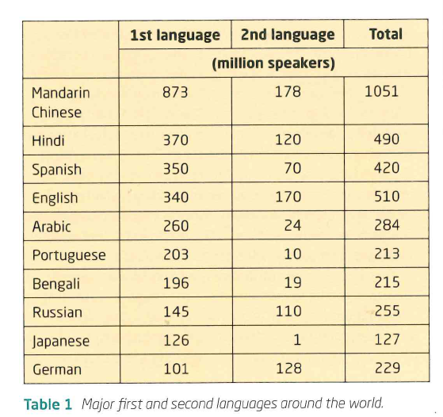
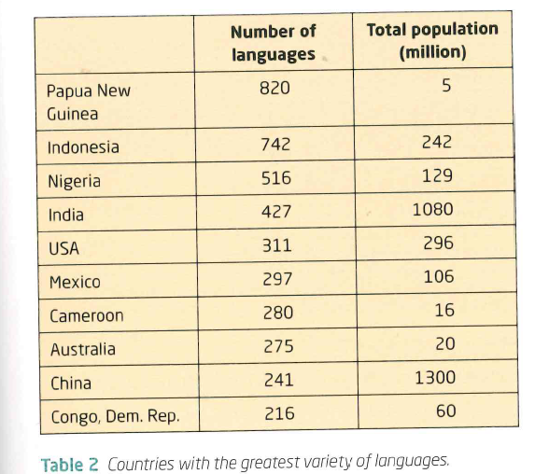
Language
Demo A: What are 5 most spoken languages in the world? List
Demo B: What 5 countries have the most amount of languages? List

Slide 9
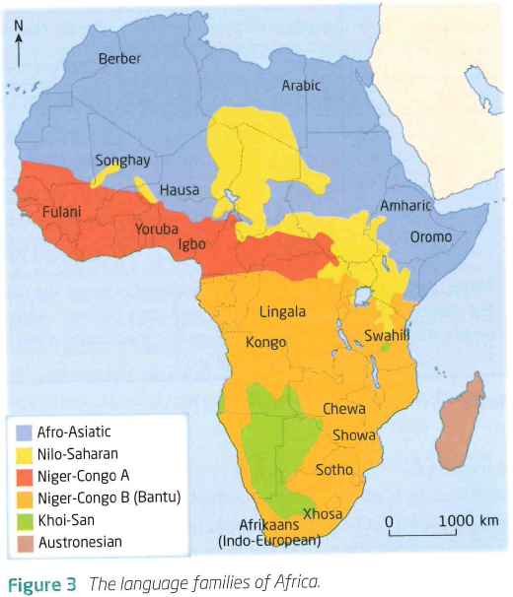
Africa a divided Continent

Slide 10
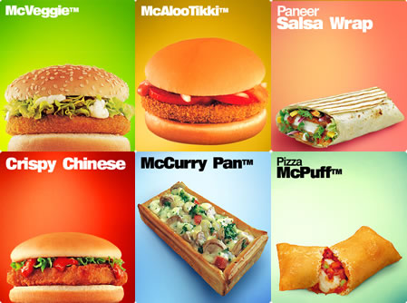
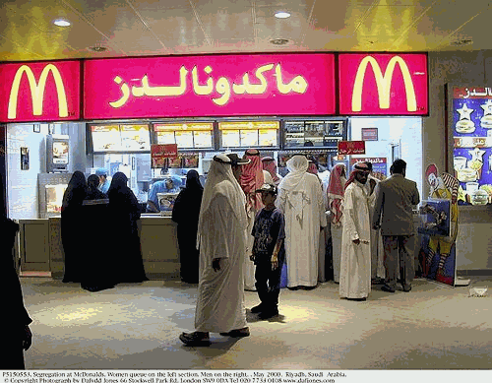
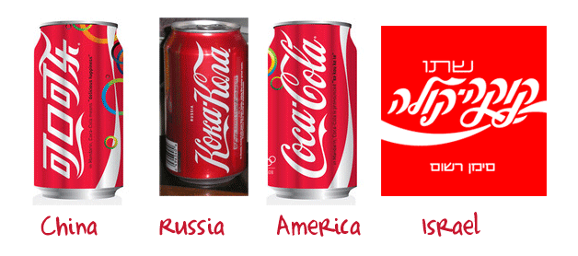
Cultural Traits
Learning Objective: To examine the diffusion of cultural traits resulting from the international movement of workers and tourists and commodities.
Demo: In what way could culture be diffused here?
Cultural Diffusion is the process of the spreading of cultural traits from one place to another.

Slide 11
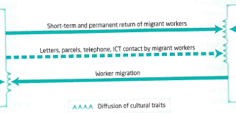
Cultural Traits
Demo: What does the diagram infer about cultural diffusion?
Why might this be?
What can I see?

Slide 12
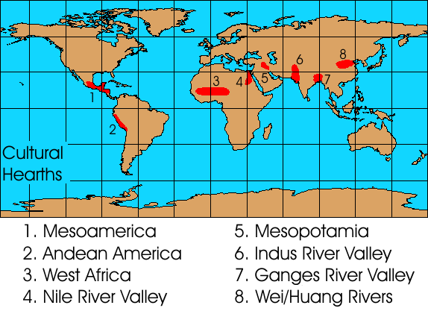
Where have we come from?
Extra Reading
Demo: Why are these the places where settlements thrived?

Slide 13
International Tourism
Learning Objectives: To examine the diffusion of cultural traits resulting from the international movement of workers and tourists and commodities.
Demo: Ensure to be able to apply a detailed case study to each of the given areas.
International Movement
International Commodities
International Tourism

Slide 14
The effect of Transnational Manufacturing and services
Learning Objective : Describe cultural traits in terms of language, customs, beliefs, dress, images, music, food and technology. To examine the diffusion of cultural traits resulting from the international movement of workers and tourists and commodities.
[A01] Describe/State/outline/Identify Estimate/Determine/Define | [A02] Distinguish/Explain/Suggest/Classify/Analyse
[A03] Compare and contrast/Evaluate/To what extent/Justify/Examine/Contrast/Discuss/Compare | [A04] Construct/Draw/Label/Annotate

