Slide 1
Gentrification in Cape Town, South Africa
Language for Learning: Gentrification is the process of renewal and rebuilding accompanying the influx of middle-class or affluent people into deteriorating areas that often displaces poorer residents.
Demo: Read through pages 47-49 and complete the 4 questions (case study analysis).
TIPS
Question 1:
Plenary
Site-Location
Situation- Relationship between a particular settlement and its surrounding area.
Learning Objective: Describe land use zones including the CBD
Learning Objective: To give reasons for land use in urban areas.

Slide 2
Squatter Settlement
For a named town or city in an LEDC, describe what has been done to improve the quality of life for the people who live in squatter settlements [7]
(c) Levels marking
Level 1 (1–3 marks)
Statements including limited detail on methods used to improve
quality of life in squatter settlements.
Level 2 (4–6 marks)
Uses named example
More developed statements on methods used to improve quality of
life in squatter settlements.
Level 3 (7 marks)
Uses named example
Comprehensive and accurate statements on methods used to improve quality of life in squatter settlements, including some place specific reference.

Slide 3
Changing Characteristics of Urban areas
Learning Objective: Describe and explain why different urban areas have different characteristics and why they might change.
Demo: Complete the table, by listing the characteristic features of each area shown.
Areas/Definition/Description | Characteristic Feature
Residential Areas
Industrial Areas
Open Spaces
The Rural-Urban Fringe

Slide 4
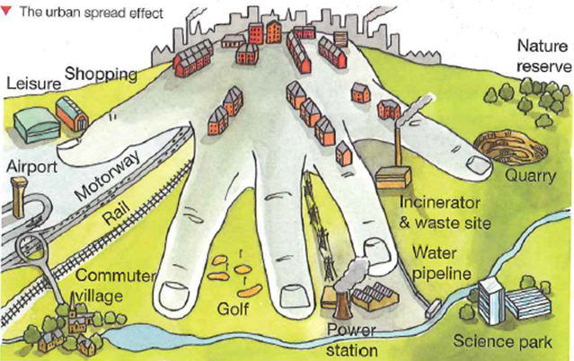
The Urban Fringe
Language for Learning: The rural-urban fringe is the area at the edge of a city where it meets the countryside. There are many pressures on the rural-urban fringe.
The Urban sprawl - is the unplanned and uncontrolled physical expansion of an urban area into the surrounding countryside.
Suburbanisation - the growth of areas on the fringes of cities. It is one of the many causes of the increase in urban sprawl. Many residents of metropolitan regions work within the central urban area, and choose to live in satellite communities called suburbs

Slide 5
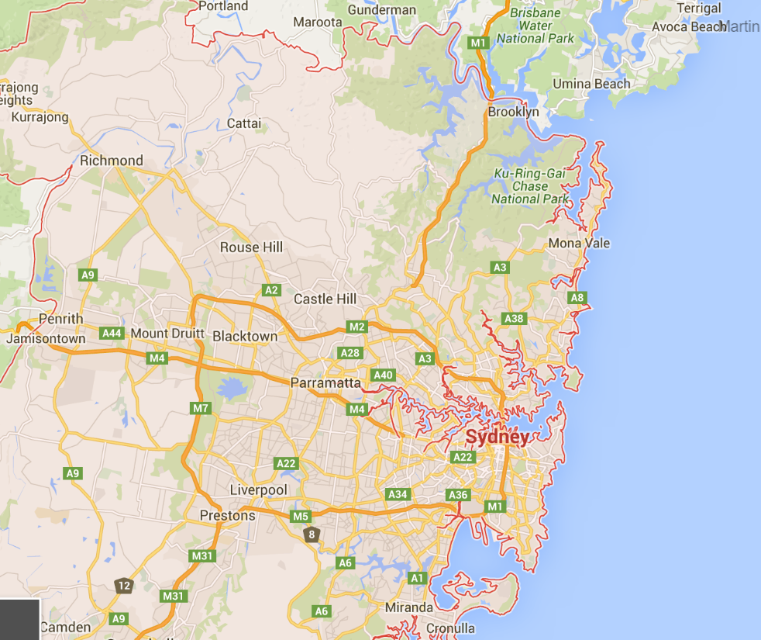
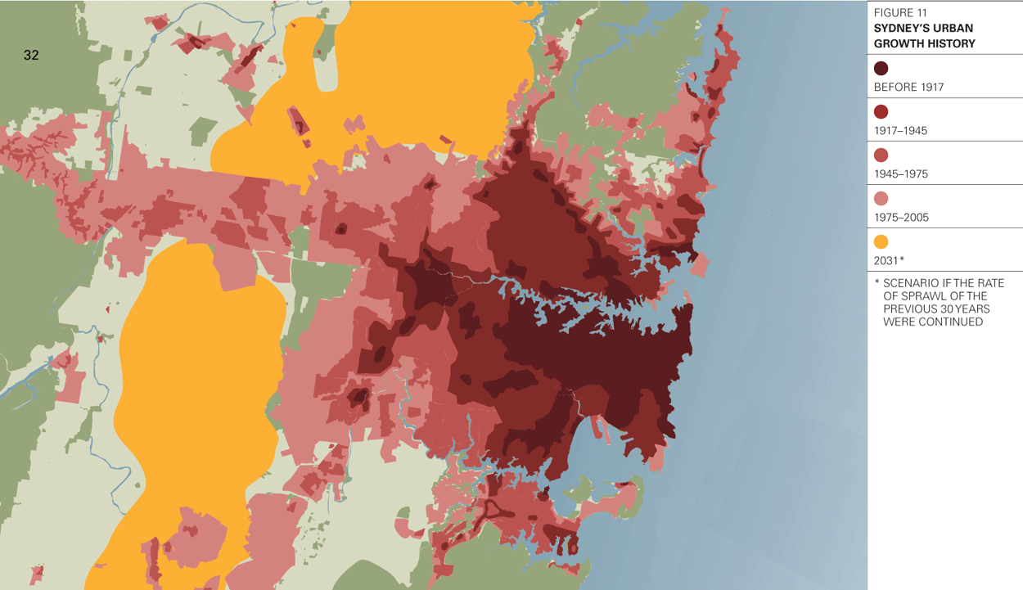
Example: The Urban Fringe
Demo: Read pages 53 in the book and complete task 3.

Slide 6
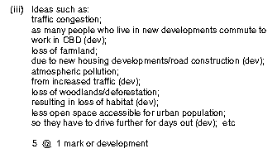
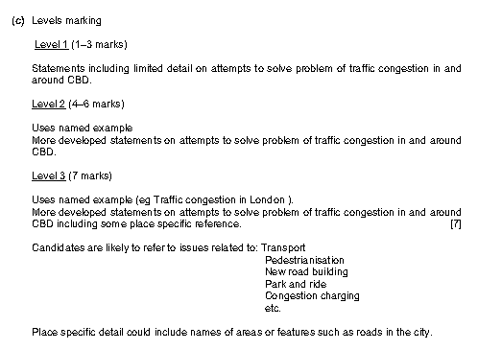
Plenary
Exam Question: 1
5
Markscheme
Exam Question: 2
The next Assessment will be on the:

Slide 7
Urban Problems and Solutions
Demo: In your Groups read the information and summarise the problems and solutions. Ensure to provide Facts and Figures.
Problems | Example | Problems | Solutions | Facts and Figures
Pollution (air/noise/ water/visual)
Inequality | New York and Detroit (p.58/59)
Housing issues | Seoul (p.60)
Traffic Congestion | London Congestion (see sheet)
Conflict over Land use | New York (p. 54/55)

Slide 8
Plenary
Exam Question 1
5
Markscheme
Exam Question 2
The next Assessment will be on the:

