Slide 1
Unit 1.Changing Population
Focus of Todays Lesson.

Slide 2
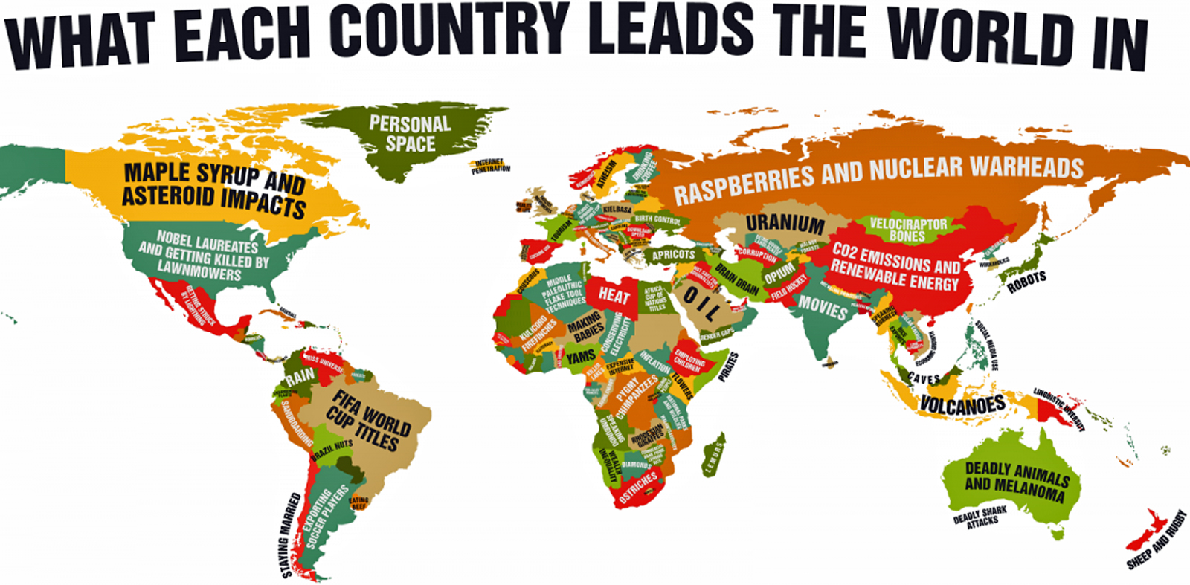

Slide 3
(iii) Use the table below to explain how Cuba is more economically developed than Kenya.
Table showing Development indicators for Cuba and Kenya
Development Indicator Cuba Kenya
Literacy rate (women) 99.8 79.7
Infant mortality (per 1000 births) 7.2 79
.................................................................................................................................................................................................................................................................................................................................................................................................................................................................................................................................................................................................................................................................................................................................................................................................................................................................................................................................................................................................................... ………………………………….[4]
Think-pair-share:
What would the important information you would Include in this answer
How would you structure your answer, why?

Slide 4
Starter:(iii) Use the table below to explain how Cuba is more economically developed than Kenya.
Table showing Development indicators for Cuba and Kenya
Development Indicator Cuba Kenya
Literacy rate (women) 99.8 79.7
Infant mortality (per 1000 births) 7.2 79
.................................................................................................................................................................................................................................................................................................................................................................................................................................................................................................................................................................................................................................................................................................................................................................................................................................................................................................................................................................................................................... ………………………………………………[4]
Write your answer!
Peer assess it! (What Went Well, Even Better If, what grade would you give it, why?)

Slide 5
How has development been represented?
Learning objective: To identify how has development been described and mapped in the past. To evaluate how valid these descriptions are.
Learning outcomes
For an 5 grade... I can identify different representations of development and describe what they show
For an 6 grade… I can explain the different representations of development using key geographical terminology
For an 7 grade… I can evaluate the limitations and benefits of the different representations of development

Slide 6
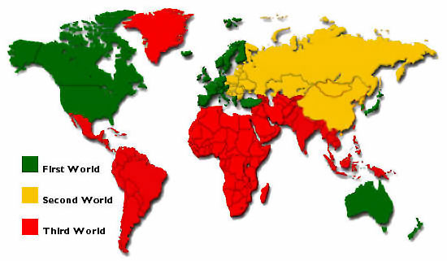
Starter: What information can you gain from this map?
What do you think 1st world, 2nd world, 3rd world mean?

Slide 7
The term first world refers to western developed countries.
Second world refers to the former communist states.
Third world refers to the less developed world.
Demo:
Copy the above definitions
Give 3 examples of countries in each category
I think this is an accurate/un-accurate representation of the world because….

Slide 8
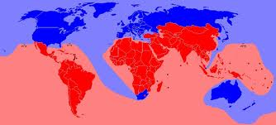
The Brandt line
Read through and answer the questions on the different ways that development has been represented.

Slide 9
The Brandt line
Demo: Answer the following questions in your books.
What are the similarities and differences between the two maps?
2) ‘In the 1980s a new term, Developing Country, was used to emphasize the changing nature of development. This was because although ‘Less Developed Country’ had replaced ‘Third World’ in the 1970s, there were still criticisms.’
Why do you think ‘Less Developed Country’ and ‘third world’ were thought to be disrespectful terms?
Similarities | Differences
Challenge: what do you think ‘developed’ and ‘developing countries’ should be know as, why>

Slide 10
Demo: Describe the distributional change over time. [4 marks]
Exam Skill

Slide 11
World Development Indicator
In 1978, the first World Development Report introduced groupings of "low income" and "middle income" countries using a threshold of $250 per capita income as threshold between the groups. In the 1983 WDR, the "middle income group" was split into "lower middle" and "upper middle" groups, and in 1989 a "high income" country definition was introduced.
Information
As of 1 July 2018, low-income economies are defined as those with a GNI per capita of $995 or less in 2017; lower middle-income economies are those with a GNI per capita between $996 and $3,895; upper middle-income economies are those between $3,896 and $12,055; high-income economies are those with a GNI per capita of $12,055 or more.
EXAM SKILL
Information
Demo: Summarise the Information provided. Ensure to be able to quantify low-income economies/ middle income/ high income countries
Demo: Create a chart and list the low-income economies/ middle income/ high income countries

Slide 12
Classification of nations
Demo: How can nations be classified?
World bank
Low income: $1,025 or less
Lower middle income: $1,026 to $4,035
Upper middle income: $4,036 to $12,475
High income: $12,476 or more
The developing/developed countries taxonomy became common in the 1960s as a way to easily categorize countries in the context of policy discussions on transferring resources from richer to poorer countries (Pearson et all, 1969)
The IMF
Advanced and Emerging and Developing Economies.
Advanced Economies are sub-catergorised[10] into Euro Area, Major Advanced Economies (G7), Newly Industrialized Asian Economies, Other Advanced Economies (Advanced Economies excluding G7 and Euro Area), and the European Union
MEDC- More economically developed countries
NIC- Newly Industrialised Country
LEDC- Less Economically Developed Country
Challenge: What is the global distribution of population?

Slide 13
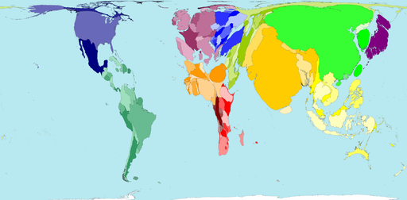
Think-pair-share
What do you think this representation of the world shows, why?

Slide 14
Do you think this worldmapper representation of HDI is accurate, why?
The map shows the population of each territory multiplied by the Human Development Index of the United Nations Development Program. This is a measure of quality of life. It combines measures of health, wealth and education in a territory. In 2004, an optimum score of 1000 was achieved where life expectancy was 85 or more years, adult literacy was 100%, school enrolment was 100% and the Gross Domestic Product is US$40 000 or more per person per year.
Norway has the highest score of 956; Sierra Leone has the lowest score of 273. The world average is 698.

Slide 15
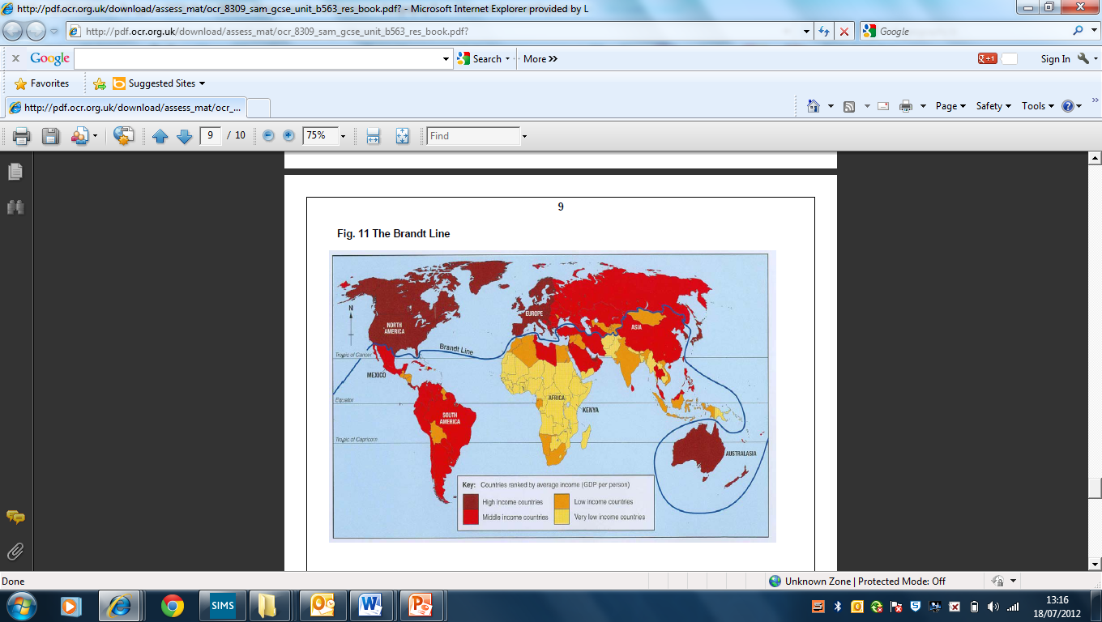
(a) Study Fig. 11 in the Resource Booklet. It shows the average income (G.D.P.) of countries.
(i) Describe the distribution of middle-income countries. Refer to the Brandt line in your answer.
.............................................................................................................................................
........................................................................................................................................ [2]

