Slide 1
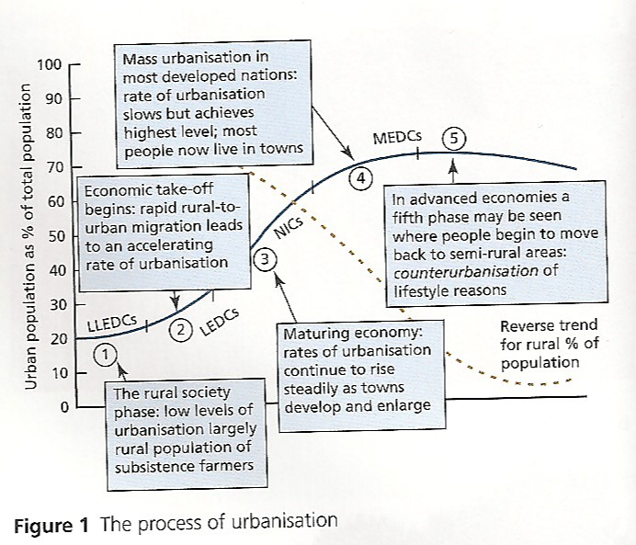
Urbanisation
Demo: Describe the process of urbanisation.
Language for learning: Urbanisation- is an increase in the percentage of a population living in urban areas.
Plenary
Key Learning Questions
What is Urbanisation?
What are the reasons for rapid urban growth?
What are the impacts of urban growth on both urban and rural areas?
What are the strategies to reduce the negative impacts of urban growth?

Slide 2
Megacities
Language for learning: What is a megacity?
A megacity is a city with a population of more than 8 million people
Switzerland and Austria both have populations of around 8 million
In 2010, there were about 25 cities falling into the megacity category
In the late 90s, the 8 million definition became common.
Changing definitions:
In the 80s ‘megacity’ referred to cities of over 5 million people.
Today 10 million is often used.
This change reflects the rapid urbanisation of the planet.
What was ‘big’ in 1980 does not seem very big at all today.
Both 8 and 10 are acceptable definitions in your exams.
Challenge: Turn to page 63 and create a table like below and ensure to add the examples.
1950 | 1975 | 2000 | 2015
1Example | 2 Examples | 3 Examples | 4 Examples

Slide 3
Question: What are the reasons for rapid urban growth?
Social
Learning language:
Internal Migration
Population density
Infrastructure
Economic
Physical
Linking your learning

Slide 4
Question: What are the impacts of urban growth on both urban and rural areas?
Urban |  | Rural
Problems | Solutions | Problems | Solutions

Slide 5
Question: What are the impacts of urban growth on both urban and rural areas?
Urban |  | Rural
Problems | Solutions | Problems | Solutions

Slide 6
Case Studies: Approaching your Case Study
Tip: Ensure to focus on these areas when covering any case study.
A01 Knowledge
Where?
A02 Analysis
When?
How?
A03 Evaluation
What has changed over time?
Geographical
language
Case Study
Can it be managed?
Facts & Figures
Why?
What?

Slide 7
Case Studies: Approaching your Case Study
Tip: Ensure to focus on these areas when covering any case study.
A01 Knowledge
Where?
A02 Analysis
What?
How?
A03 Evaluation
What has changed over time?
Geographical
language
Case Study
Facts & Figures
Can it be managed?
Why?
When?

