Slide 1
Homework
http://education-portal.com/academy/lesson/world-systems-theory-core-vs-peripheral-societies.html#lesson

Slide 3
How is a banana linked to the SISS?
What does the Empire have to do with this?
Tele-communications/Internet
Culture
Finance
A shrinking world
How has if affected?
Globalisation
Examples?
Definition ?
People
Global Village
Politics
Chindia?
Definition ?
North South Divide
Migration
Definition ?
Trade Routes/ Trading blocs
What trade routes?/Examples
Containerisation
Is development linked to Globalisation?
Definition ?
Measuring Development?

Slide 4
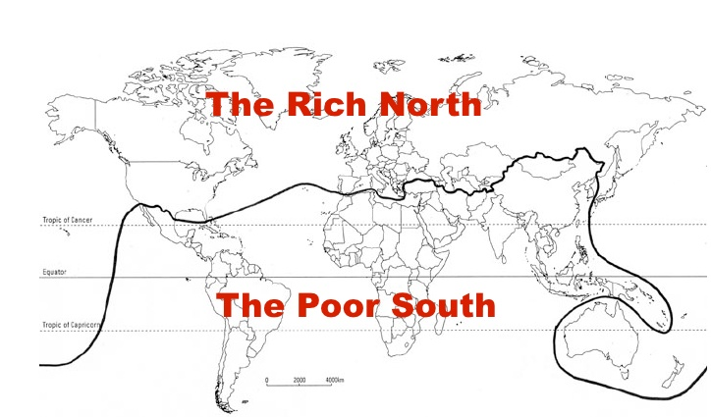
North vs. South
North-developed Core
25% of the global population
High levels of education
90%of global manufacturing output
95% of global spending on R&D
Control global finance and trade
75% of global population
Limited spending on R&D
10% of global manufacturing output
20% suffer from malnutrition
Dependent on the North for medical supplies

Slide 5
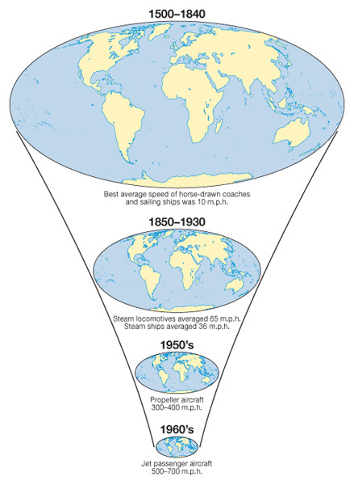
Changing Space- the shrinking world
Learning Objective: To be able to explain how a reduction in the friction of distance results in time–space convergence.
Starter: Explain the relationship between Idiot Abroad Series 2 and the reduction of friction of distance and resultant time space convergence.

Slide 6
Lesson Glossary (Language for Learning)
Friction of Distance: This is the reduced likelihood of people using a service the greater the distance that they live from it. Distance is an issue due to the time and costs to overcome it. e.g. reduction in commuting to IST with increasing distance from Colomiers. Friction of distance is closely related to transportation and accessibility.
Time-Space Convergence: This is when travel time between places decreases and distance declines in terms of its significance. It is generally brought about by transport innovations and improvements e.g. Airbus A380 can fly Paris to Adelaide in just 20 hours in 2013. (see first image on the right)
Transnational corporation (TNC)- a firm that owns or controls productive operations in more than one country through foreign direct investment.

Slide 7
Success Criteria
Learning Objective: To be able to explain how a reduction in the friction of distance results in time–space convergence.
If you are going to achieve a 1 you will be able to:
If you are going to achieve a 3 you will be able to:
Give a developed and well-substantiated explanation and reasoning as to how a range of nations built up their naval arsenal.
Analyse the effects this had on Germany and the stability of Europe.
Give an accurate,
structured description
as to how and a range of nations built up their naval arsenal.
Start to weigh up the positive and negatives that this had on Europe.

