Slide 1
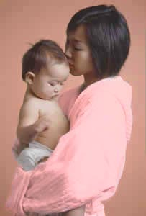
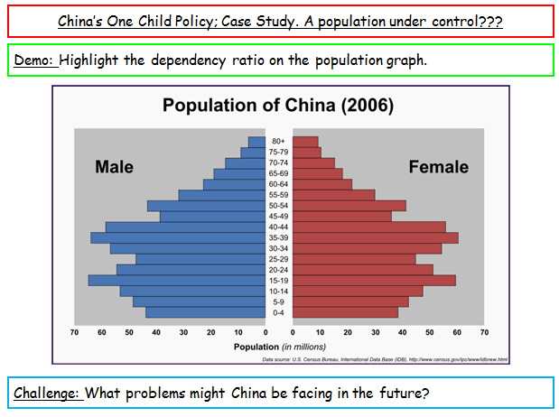

China’s One Child Policy; Case Study. A population under control???
Learning Objective: To evaluate the effect of China’s one child policy on its population.
Starter: Complete your worksheet.
Your Worksheet
Key Term:
Anti- natalist policy: A population policy that aims to limit fertility through the use both of incentives and deterrents.

Slide 2
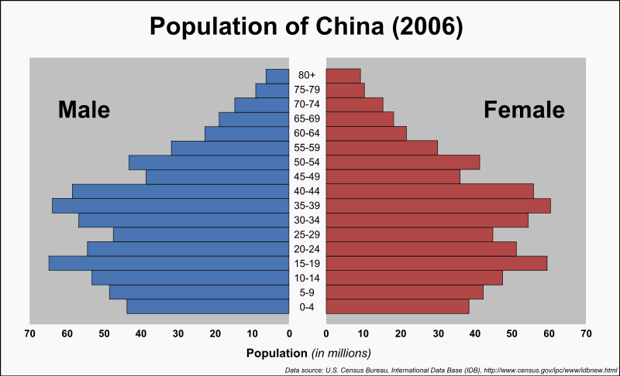
China’s One Child Policy; Case Study. A population under control???
Demo: Highlight the dependency ratio on the population graph.
Challenge: What problems might China be facing in the future?

Slide 3

Until the 1970s the Chinese government regarded a growing population as a quick way to economic development. In 1963, the average number of children born was 7.5 (UK today is 1.6).
UK
China

Slide 4
Population = 1.4 billion
Optimum (best) population = 0.7 billion

Slide 5
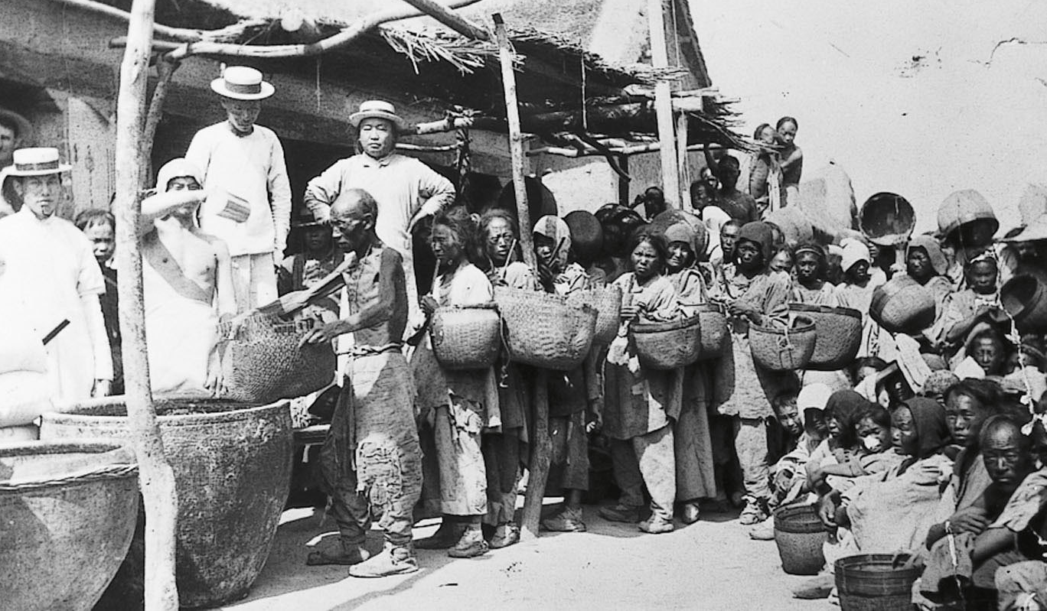
With 21% of the world's population, but only 7% of the world's arable (farm) land, population growth brought about extreme poverty & famine.
China's government now views population growth differently

Slide 6
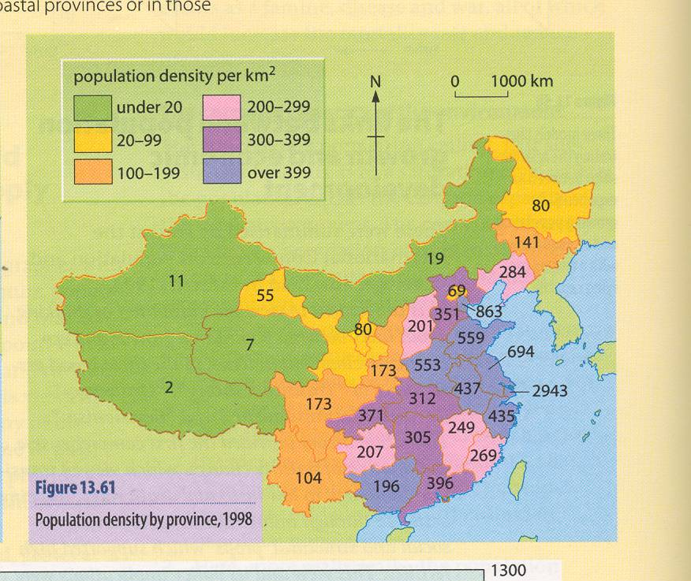
Demo: Looking at this map what do you think would be the logical (simple) solution to over crowding in China?
USA = 30
UK = 322

Slide 7
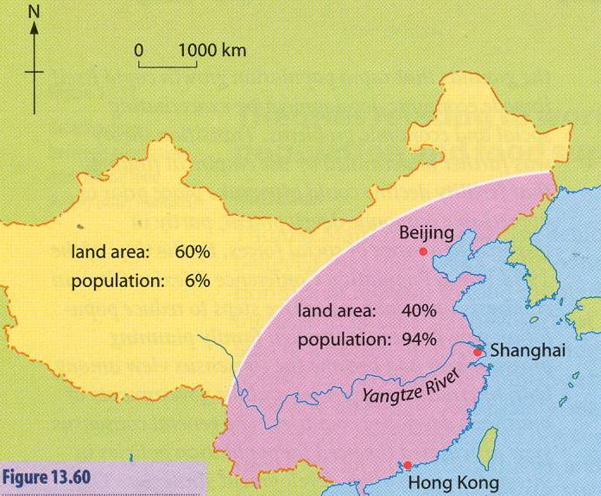
The communist regime tried to force people to the west of the country. This was unsuccessful as the west is an arid region (almost desert).
Demo: Draw up a timetable of China Anti Natalist Policy.
Vertical Timetable

Slide 8
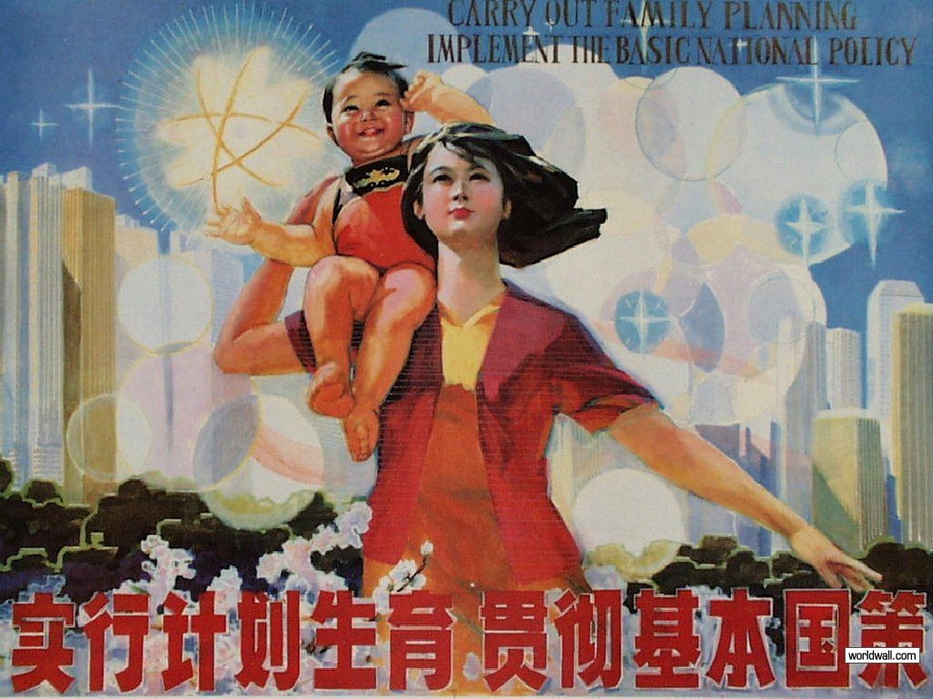
Demo: What is predicted to happen to the population in the first half of the twenty first century? (2)
To solve it’s overpopulation problem the Chinese introduced a one-child policy to limit growth. They did it to provide a long-term future in which all can enjoy a satisfactory standard of living based on existing resources.

Slide 9
Demo: Split them into incentives & punishments.
China's One-Child Policy
Couples need government permission to marry.
Women must be 25 before they marry.
Couples must sign an agreement only to have 1 child.
Women must ask officials for permission to try for a baby, or the child doesn’t legally exist!
Couples with 1 child receive free health care, monthly allowance, priority housing and improved pensions upon retirement.
f) Family planning advice is given
g) Couples who have 2 children must pay back all benefits received and a fine.
h) Workmates, family and neighbours are encouraged to report pregnant women.
i) Forced abortions and sterilisations have been carried out.
j) Nurses are employed to check that women without permission are not pregnant.
Challenge: Order them best (1) to worst (10).

Slide 10
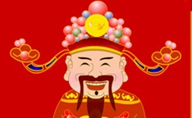
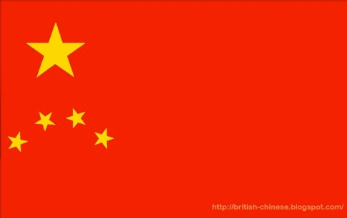
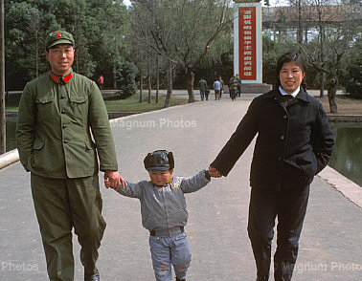


Exceptions to the rule
membership of a minority ethnic group.
having a first child with a disability
pregnancy after adopting a child
rural families with 'real difficulties of losing the family line' (all children being girls)

Slide 11
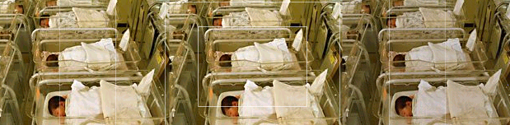
With most Chinese couples only having one child, since 1979 there have been 400 million less births.
Demo: Why would this have helped the babies that were born in that same time to have a better standard of living? (3)

Slide 12
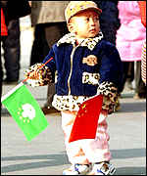
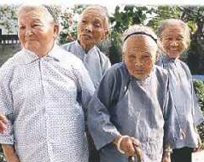
Problems caused by the policy
People live longer due to improved health care, but have less family to support them. This will only get worse as the policy keeps working (400 million over 60’s by 2050).
Ageing population
Kids, mainly boys, are spoiled rotten, as grandparents only have one grandchild to treat
‘Little emperors’

Slide 13
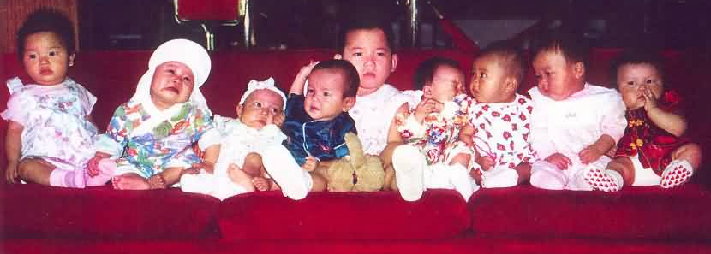

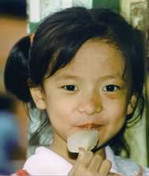
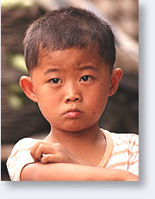
Imbalance of the sexes
China has mostly girl orphans, due to a cultural bias towards males.
More worrying though is that females babies are far more likely to be aborted. There are now nearly 20 million more men than women of marriage age.
119 newborn boys
100 newborn girls

Slide 14
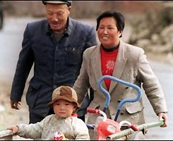

One child policy, is it necessary?
If China’s population had continued to grow at the same rate as the 1970’s, the annual increase of population would be 40 million and not 17 million as it is today. However, should they have waited for a higher level of economic development. This would have initiated a natural decline in birth rate as in MEDC’s?
Demo: Could we have really afforded to wait and see???

Slide 15
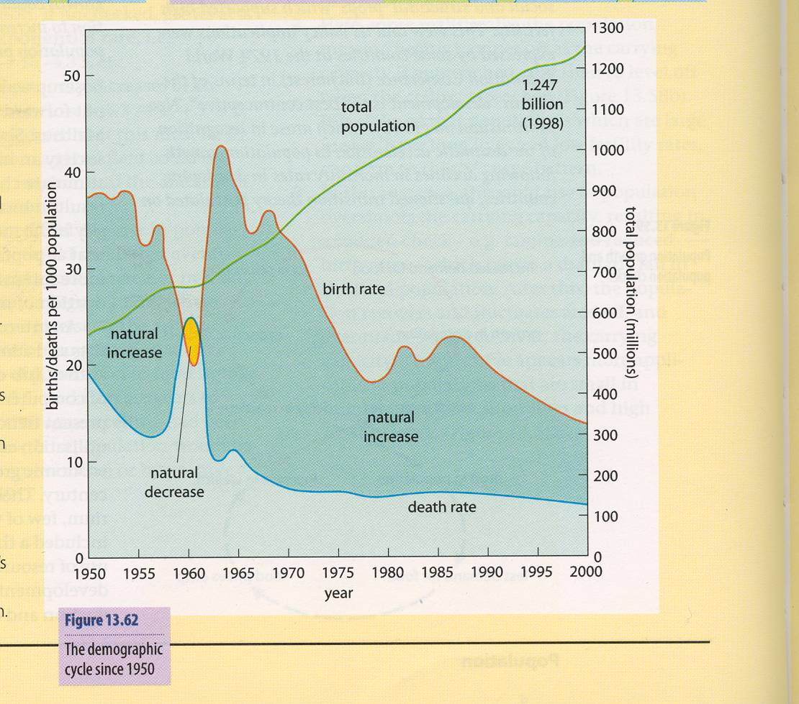
The demographic cycle since 1950

