Slide 1
Defining a City
Starter: Why might it be difficult to define a city? (A01)
Counting residents to work out the size of a city is no simple task
Migrants, homeless people and illegal residents complicate the count
The administrative boundary of a city often does not reflect its resident population as the diagram for London shows
Because of this, it is common to come across very different stated population sizes for the same city
Cross-curriculum link:
Defining Language is hard and changes according to geographical place, economic and social background, education and age. Many variables contribute to what we see and understand language to entail and mean.

Slide 2
The growth of megacities
Demo: How has the pattern of Megacities changed over time? (3marks)
Cities of 8 million+ from 1950 to 2010

Slide 3
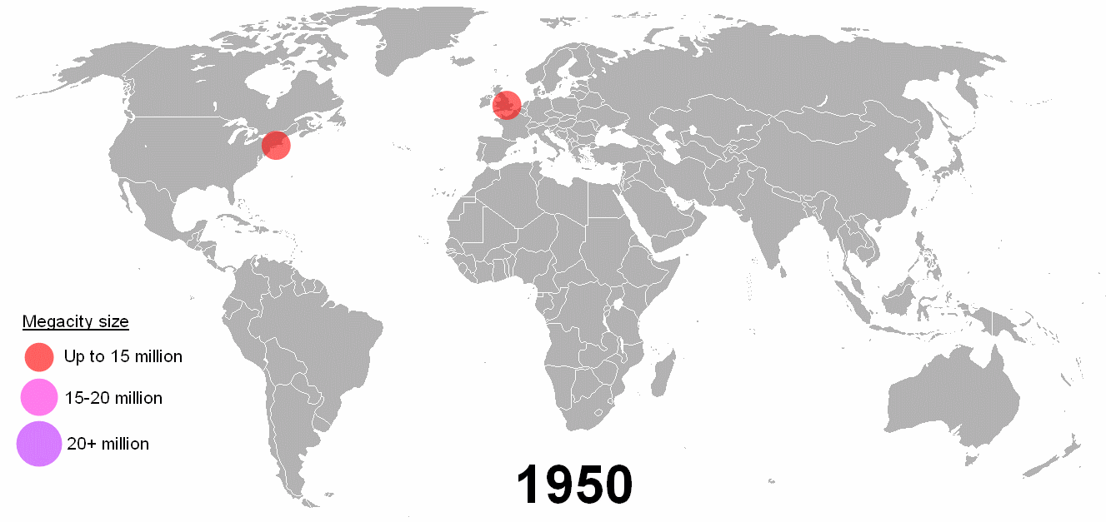
Changing patterns
Demo: How has the pattern of Megacities changed over time? (3marks)
In 1950s and 1960s the world’s largest cities were in developed countries
In the 1970s, several Latin American megacities emerged
From 1960 to 1990 a few developed world megacities, such as London, actually saw population decline due to deindustrialisation and counter-urbanisation
Since 1990 megacity growth has been centred on Asia, and especially India and China since the turn of the millennium
Africa has relatively few megacities although many African cities are growing rapidly
It is important to recognise that megacities around the world have very different characteristics

Slide 4
Changing patterns
Demo: What Factors have led to the growth in megacities?
Factors
Higher-level thinking: Ensure to classify/categorise the factors named.

Slide 5
Cores (network hubs/nodes), peripheries and those areas in-between!

Slide 6
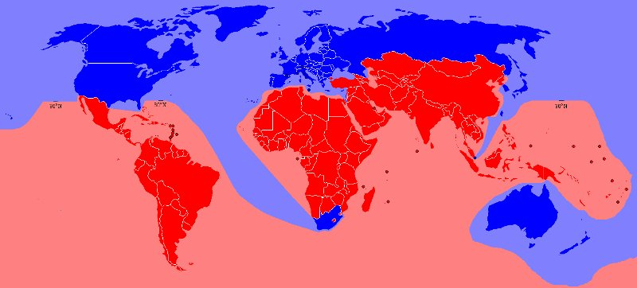
Cores (network hubs/nodes), peripheries and those areas in-between!

Slide 7
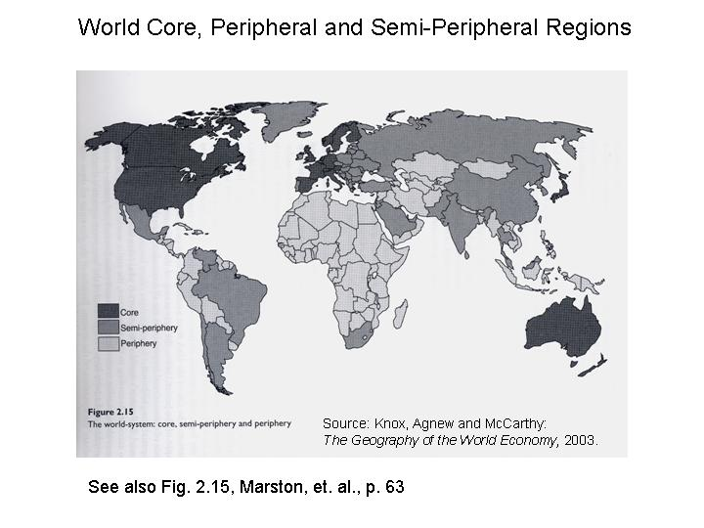

Slide 8
Cores (network hubs/nodes), peripheries and those areas in-between!
Friedman (1966)

Slide 9
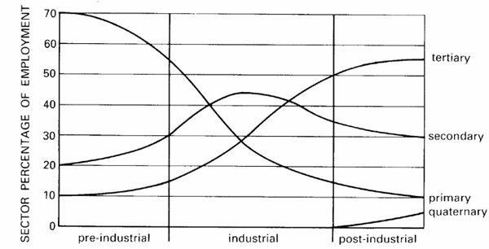
Clark-Fisher model

Slide 10
Understanding key language
Primary Sector | businesses in this sector are involved in getting raw materials from the land and sea.
Secondary Sector | businesses in this sector use raw materials and change them into things we can use.
Tertiary Sector | businesses in this sector provide a service to people.
Quaternary Sector | businesses in this sector is the knowledge-based part of the economy, which typically includes knowledge-oriented economic sectors such as information technology; etc.

Slide 11
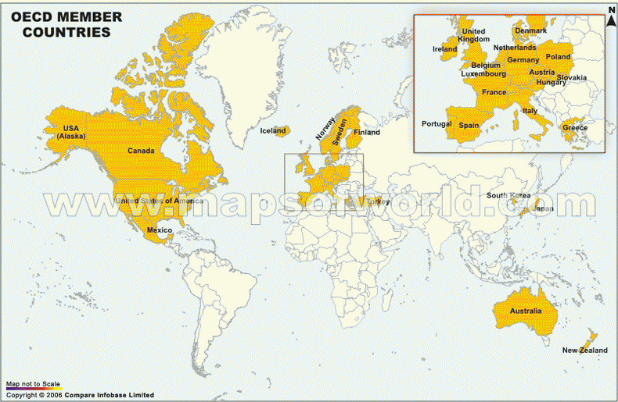

Slide 12
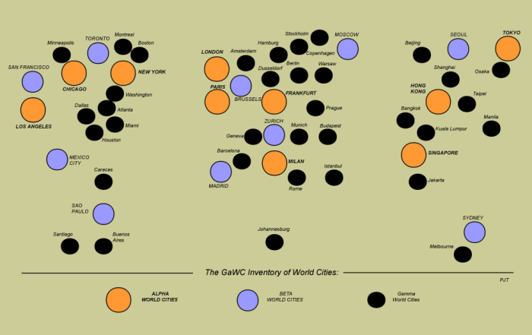
Cores (network hubs/nodes), peripheries and those areas in-between!

Slide 13
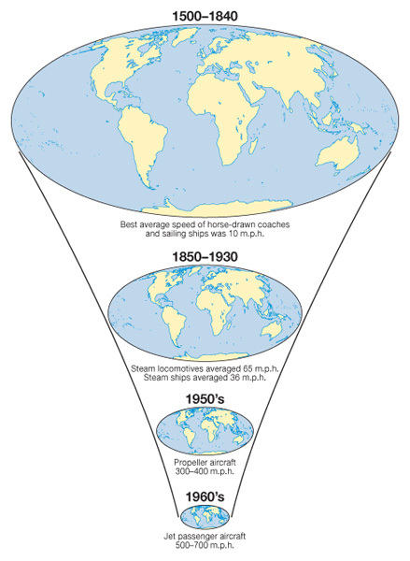
Changing Space- the shrinking world
Learning Objective: To be able to explain how a reduction in the friction of distance results in time–space convergence.
Demo: Explain the relationship between Idiot Abroad Series 2 and the reduction of friction of distance and resultant time space convergence.
Time-Space Convergence: This is when travel time between places decreases and distance declines in terms of its significance. It is generally brought about by transport innovations and improvements e.g. Airbus A380 can fly Paris to Adelaide in just 20 hours in 2013. (see first image on the left)

Slide 14
Lesson Glossary (Language for Learning)
Friction of Distance: This is the reduced likelihood of people using a service the greater the distance that they live from it. Distance is an issue due to the time and costs to overcome it. e.g. reduction in commuting to IST with increasing distance from Colomiers. Friction of distance is closely related to transportation and accessibility.
Time-Space Convergence: This is when travel time between places decreases and distance declines in terms of its significance. It is generally brought about by transport innovations and improvements e.g. Airbus A380 can fly Paris to Adelaide in just 20 hours in 2013. (see first image on the right)
Transnational corporation (TNC)- a firm that owns or controls productive operations in more than one country through foreign direct investment.

