Slide 1
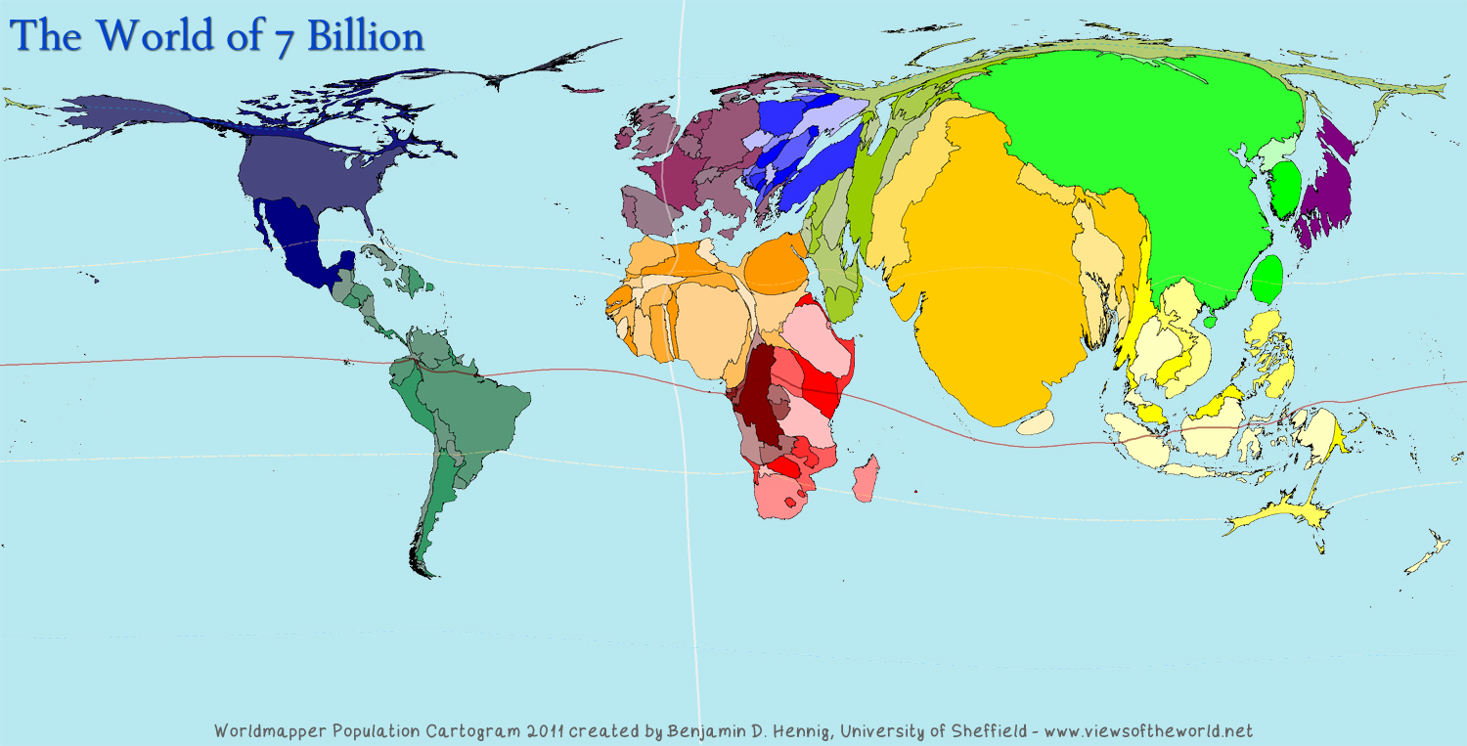
Stater Activity
Starter: Look at the Cartogram below and create a theory (using evidence and logical thought) as to what it might represent.
Language for learning: A cartogram is a map showing some form of statistical information. The geometry or space of the map is distorted in order to convey the information.
The World of 7 Billion

Slide 2
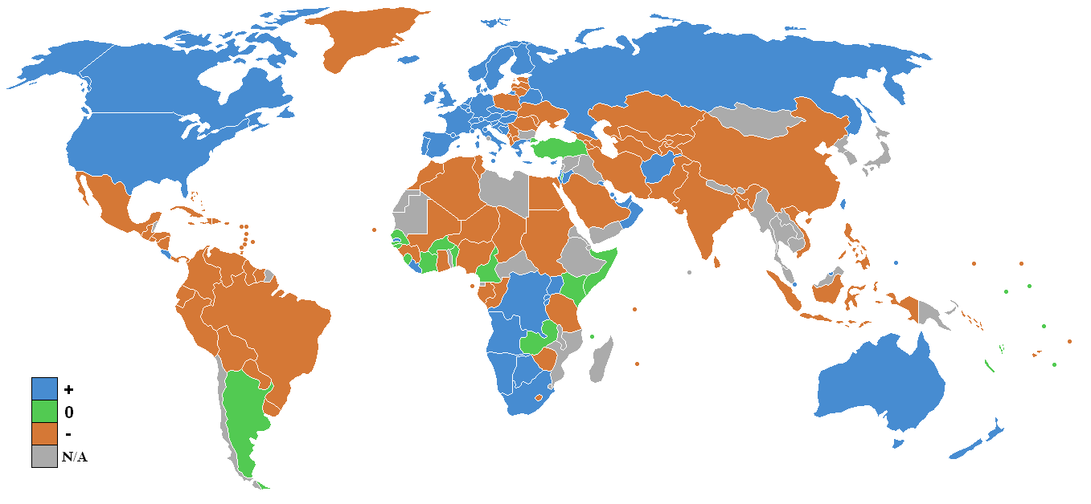
Learning Objective: To be able to describe and give reasons for the rapid increase in the world’s population.
Population and Settlement
Starter: Look at Source 1 and describe the global pattern of population shown on the map. {4 Marks)
Source 1: Global population
Mark scheme: [Award 1 mark for each point]
Have you used directional Language: North/East/South/West
Have you used Exemplification (Continents/Countries)
Have you stated which regions of the world have seen a population increase and a population decrease
Have you stated which regions or countries have seen little to no change.
Key

Slide 3
Put your knowledge into action
Demo: You will be plotting a graph with the data below. How will you lay out your axes to fit this graph in?
Your data
Demo: On your paper, plot a graph to illustrate how the population has grown since 1650.
YEAR | WORLD POPULATION (in millions, estimated)
1650 | 500
1700 | 600
1750 | 700
1800 | 900
1850 | 1300
1900 | 1700
1950 | 2500
1976 | 4000
2000 | 6500
2010 | 6850
Challenge for excellence:
Can you plot significant periods in time on your graph?

Slide 4
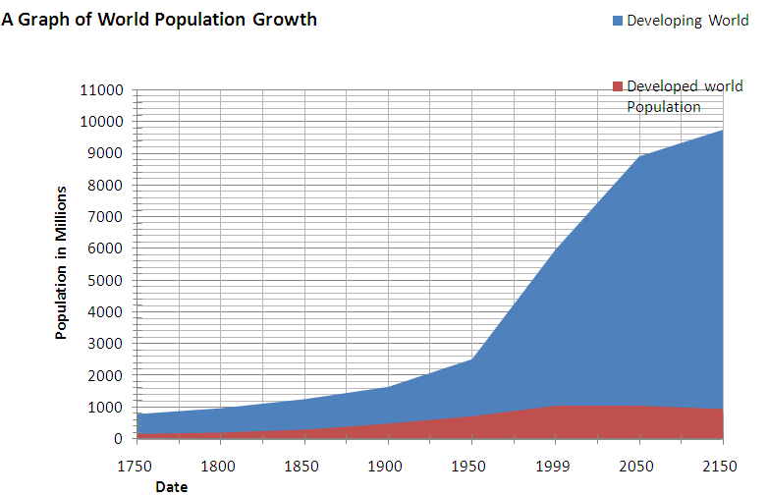
Learning from the graphs about the changing world population
Demo:
Using the graph describe how the world population has changed from 1750 to 2010. (4 marks)
Language for learning:
Here are some key words to help you with your writing.
Developing world
Developed world
Population

Slide 5
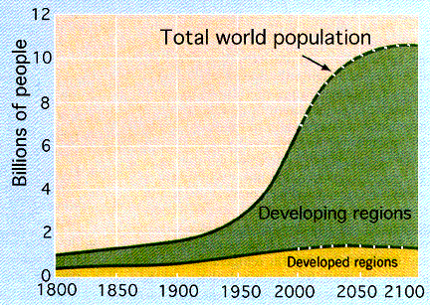
Why is Global Population Changing?
Demo: Add the developing and developed regions to your graph. Which countries are growing the fastest? Explain why some countries are growing faster than others?
Notes:
Pupils should use a whole page for this diagram

Slide 6
Why is Global Population Changing?
MEDCs have low BR and low DR
LEDCs have high BR and high DR
Birth Rates and
Death Rates.
WHY?
Plenary
Learning Objective: To be able to describe and give reasons for the rapid increase in the world’s population.
Plenary: Describe in your own words how worlds population has changed over the last 500 years
Notes:
Teacher/mini leader can lead this brainstorm on the ‘normal’ whiteboard

Slide 7
Population and Settlement
Starter: Look at Source 1 and describe the global pattern of population shown on the map. {4 Marks)
Source 1 Global population
Writing Frame:
The global pattern of population is ___________________________________
Population has increased in ________________________________________
Population has decreased in ________________________________________
Population has remained stagnant in __________________________________

Slide 8
Does it matter how big the world's population is?
Watch this video for an introduction to population growth, get ready to answer the questions on the sheet
.
http://www.bbc.co.uk/learningzone/clips/world-population-is-it-out-of-control/531.html
Your teacher will ask you to present your answers at the end so make sure that you watch and listen carefully.

