Slide 1

Overpopulation and China’s One Child Policy

Slide 2


Overpopulation and China’s One Child Policy
Learning Objective: To review Pro-natalist vs. Laissez faire approaches and Explain what impact the One Child Policy has had on China.
Starter:
There is a post-it note on your desk write down the answers to any of the following and stick on the board -
What is a Anti-natalist approach?
What is a Laissez faire approach?
Give examples of Anti-natalist vs. Laissez faire approaches
Name a country and the approach adopted.
Notes:
Teachers Task: Go through the answers and share the correct answers on the board. Also share the language for learning to help students progress. Skill AO1 Geographical Language.

Slide 3


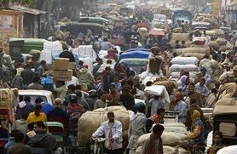


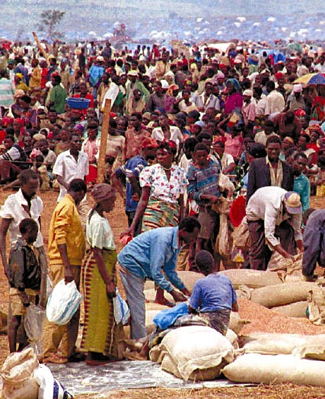
Overpopulation
Quick Questions:
Look at these photographs of overpopulated areas.
1. Are the problems in LEDC’S different to problems in MEDC’s? How?
2. How would you feel like living here?
3. How is this different to living in Germany?

Slide 4
Overpopulation
Demo: What impacts can these have on the population of a country?
Environmental Impacts
Economic Impacts
Social Impacts
Challenge: Can overpopulation ever be a good thing?

Slide 5

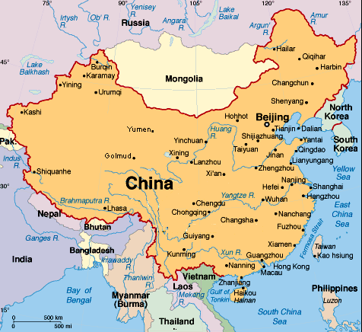
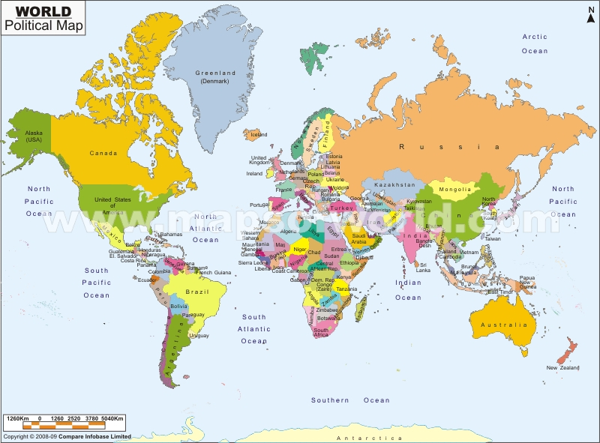
China - Case study
China introduced a one child policy was in 1979 to limit communist China's population growth.
Although designated a "temporary measure," it continues a quarter-century after its establishment. The policy limits couples to one child.
Fines, pressures to abort a pregnancy, and even forced sterilization accompanied second or subsequent pregnancies.

Slide 6
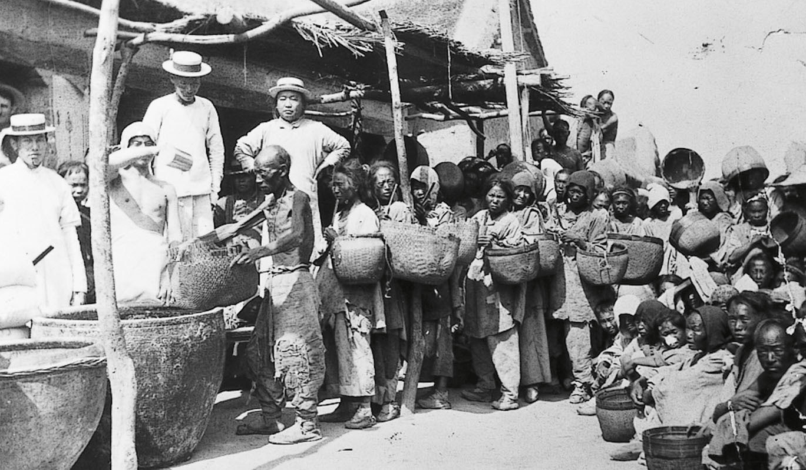
With 21% of the world's population, but only 7% of the world's arable (farm) land, population growth brought about extreme poverty & famine.
Source 1 1979
China's government now views population growth differently

Slide 7
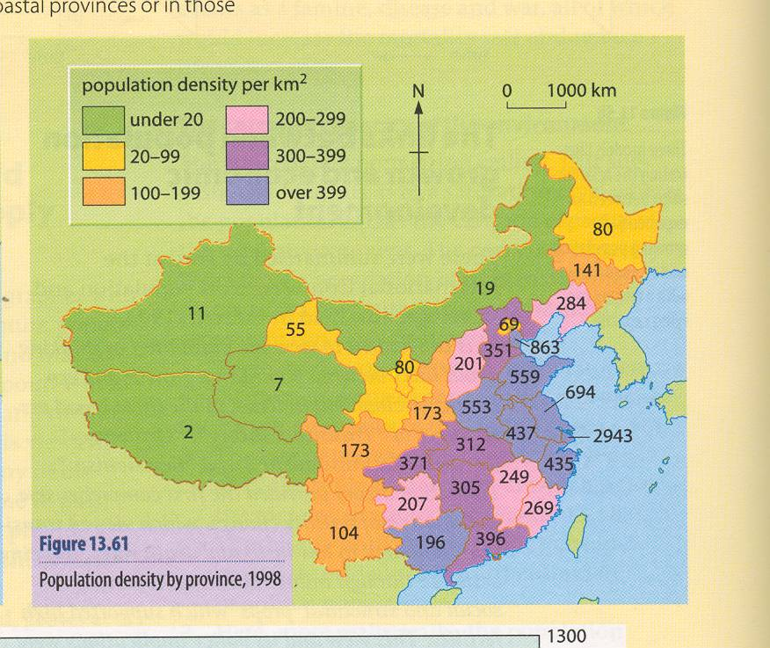
Demo: Looking at this map what do you think would be the logical (simple) solution to over crowding in China?
USA = 30
UK = 322

Slide 8
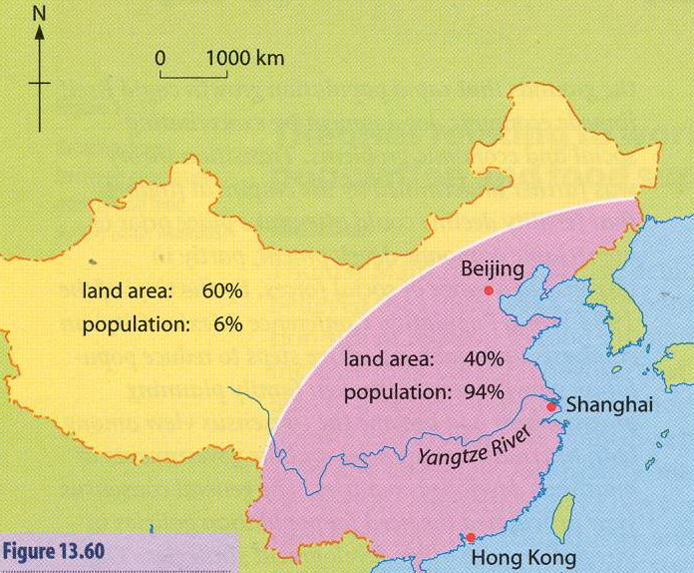
The communist regime tried to force people to the west of the country. This was unsuccessful as the west is an arid region (almost desert).
Demo: Draw up a timetable of China Anti Natalist Policy.
1979 Introduction of One child policy
Vertical Timetable

Slide 9
Demo: Split them into incentives & punishments
China's One-Child Policy
Couples need government permission to marry.
Women must be 25 before they marry.
Couples must sign an agreement only to have 1 child.
Women must ask officials for permission to try for a baby, or the child doesn’t legally exist!
Couples with 1 child receive free health care, monthly allowance, priority housing and improved pensions upon retirement.
f) Family planning advice is given.
g) Couples who have 2 children must pay back all benefits received and a fine.
h) Workmates, family and neighbours are encouraged to report pregnant women.
i) Forced abortions and sterilisations have been carried out.
j) Nurses are employed to check that women without permission are not pregnant.
Challenge: Order them best (1) to worst (10).

Slide 10
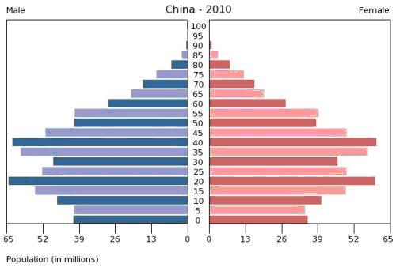
Population Pyramid Comparisons
Discussion:
Describe the population structure for China.
The population structure for China has a bulge in the middle this means that…….
This similar/different to the population structure of Kenya
In 1979 China has a population of nearly 1 billion. The government were very concerned about the impacts of a rapidly increasing population.

Slide 11
China’s One Child Policy
Demo: Write down two facts that made the government introduce the policy and two facts about the impact on the people of china.
You have each been given a fact about China’s one child policy
Read your fact and prepare to explain it to the others on your table
You must explain it in your own words so spend a few minutes now preparing by writing your own explanation in your book
Then you will listen to other people’s facts and prepare to write it down

Slide 12
China’s One Child Policy
Fact - It is mainly people living in urban areas that are subject to the One Child Policy law.
Fact - China’s population grew rapidly from 1949-1970
Fact - China’s one child policy was adopted in 1979 to limit China’s population growth.
People have been fined, pressured into abortion and been forced into sterilization to avoid a second baby.
Fact - The rule has caused an uneven population pyramid with more young males than females and many ‘only’ children.
Fact - It has also caused abandonment and killing of many baby girls.

Slide 13
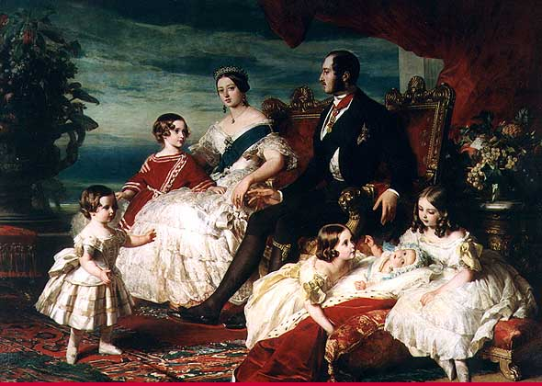
Overpopulation is a hot topic: Small Research Project!!
HOMEWORK - Explain how one country (of your choice) has approached the problem of and debate whether you think the approch is sustainable.

