Slide 1
Unit 1.Changing Population
1a.Population and economic development patterns
1b.Changing population and places
1c.Challenges and opportunities

Slide 2
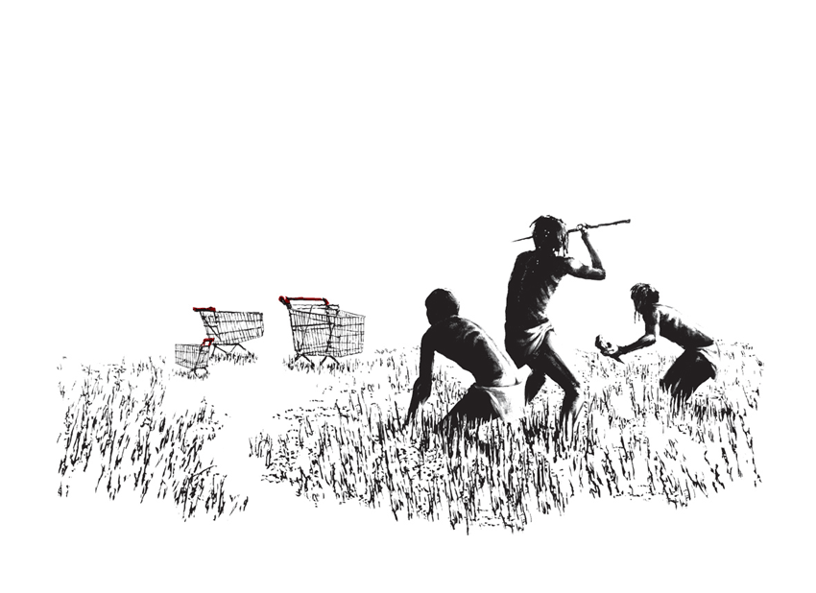

Geographical Source Work?
Specification: Oblique photographs will be used. Candidates should be able to describe human and physical landscapes (landforms, natural vegetation, land-use and settlement) and geographical phenomena from photographs. Simple descriptions only will be required. Cartoons illustrating a geographical theme may be set for interpretation and analysis.

Slide 3
Infographics

Slide 5
SL Components

Slide 6
HL Components

Slide 7
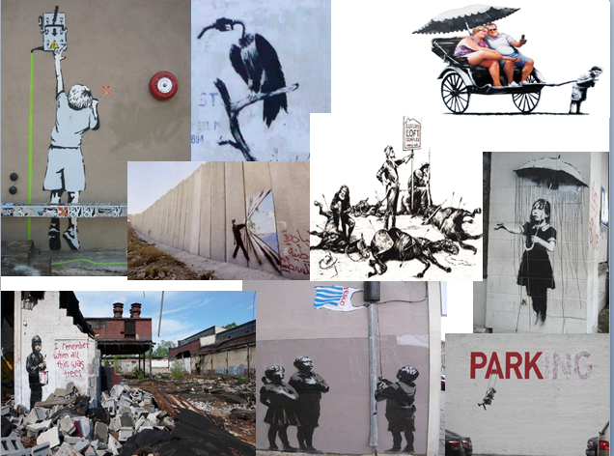
Geographical Source Work?

Slide 8
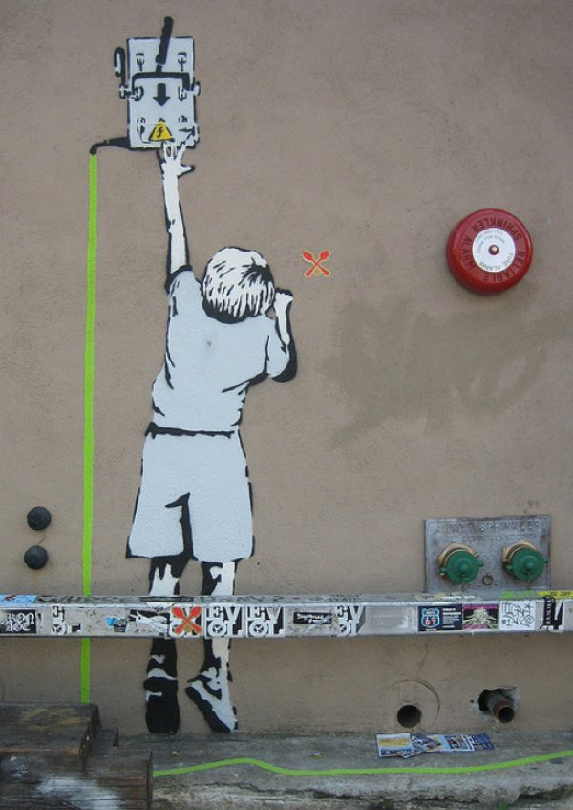

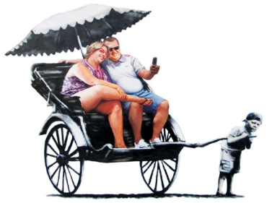
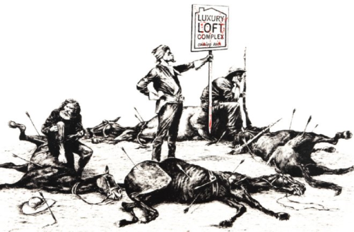

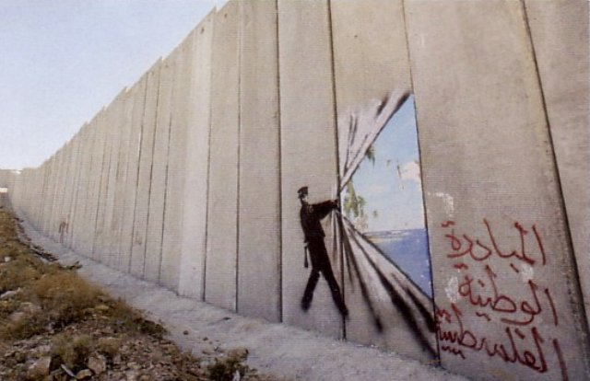

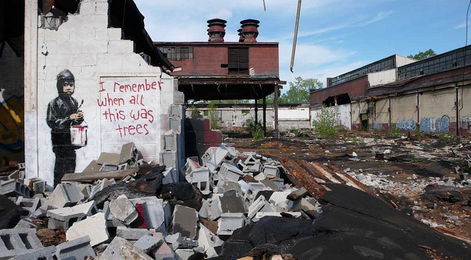
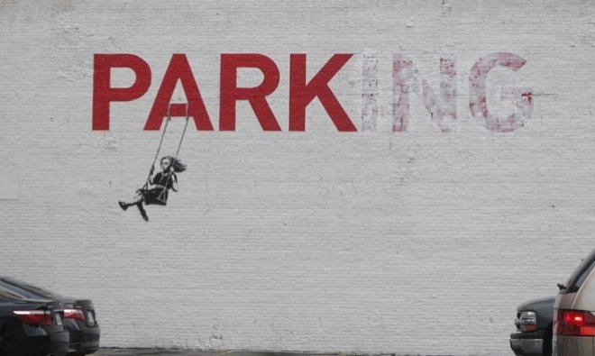

Slide 9
Population, resources, government/multi-governmental organizations, settlement, culture and economic development
What are the interrelationships?

Slide 10

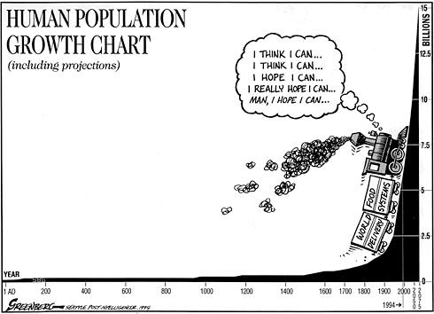
Geographical Source Work

Slide 11
Exam Questions
To what extent do migrations bring benefits to both their origins and their destinations? [10]

Slide 12
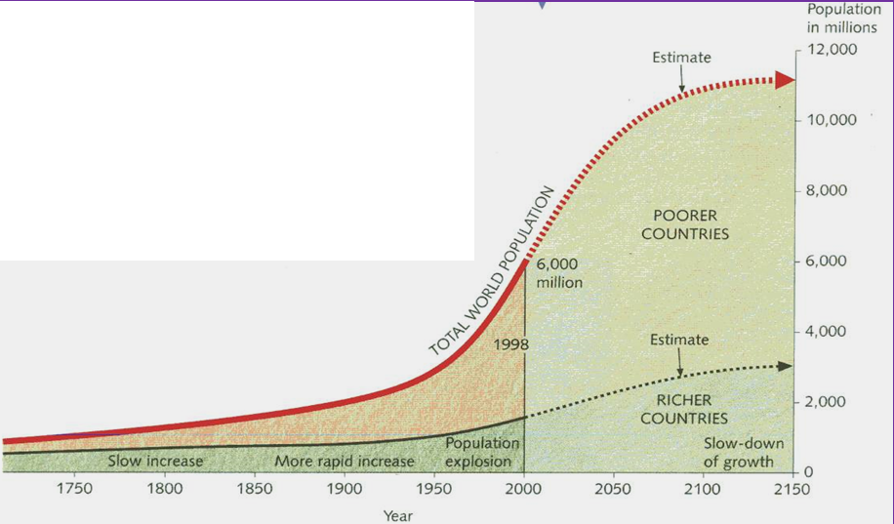
Graph Work
Demo: Describe the population graph. [4marks]
Population growth was slow but steady until the early 19th century. Since then it has grown at a much faster rate. Estimates suggest that, at present, it is growing by just over 90 million people each year. Population growth has not been even throughout the world. It is more rapid in some countries than in others. The graph also shows that, the fastest growth has been in the world’s poorer countries. Growth in the richer countries is now very slow. Some nations in the north-west Europe even have a zero population growth. That means neither an increase nor a decrease.
Model Answer

