Slide 1
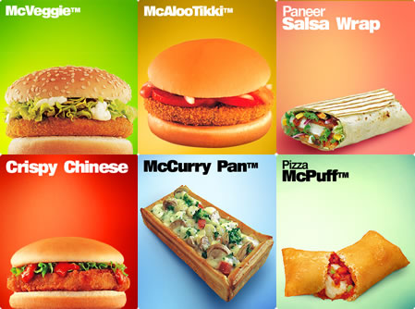
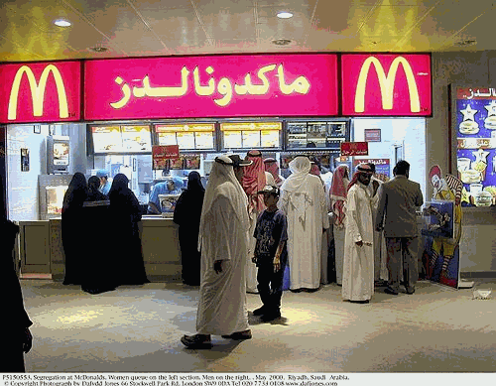
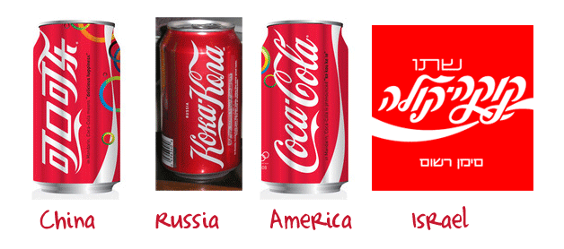
Cultural Traits
Learning Objective - To examine the diffusion of cultural traits resulting from the international movement of workers and tourists and commodities.
Demo: In what way could culture be diffused here?
Cultural Diffusion is the process of the spreading of cultural traits from one place to another.

Slide 2
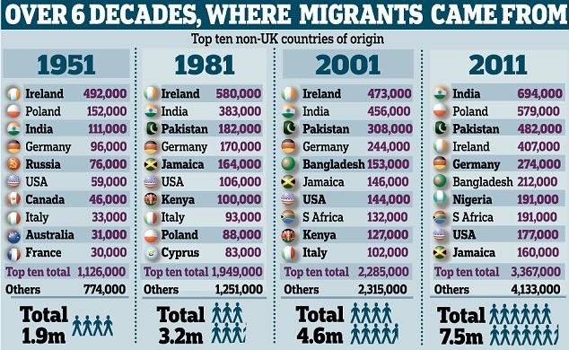
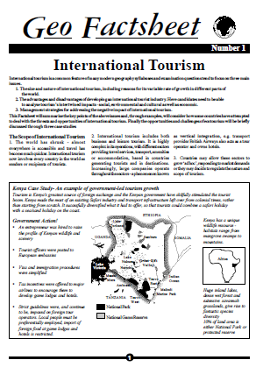
Cultural Traits and diffusion.
Demo: How has migration changed over time and what has made this change possible?
Migration over time
Worksheet
Challenge: Read through the Geo Factsheet and see how International tourism has expanded.

Slide 3
Glossary
Success Criteria
Learning objective: Describe the role of TNCs and media in spreading consumer culture. Select two different branded commodities and examine the spatial and temporal pattern of adoption on a global scale.
Learning Outcome:
Consumer Culture –the equation of personal happiness with consumption and the purchase of material possessions.
Mass Media- a section of the media specifically designed to reach a large audience. The term was coined in the 1920s with the advert of nationwide radio networks, and mass- circulation newspapers and magazines.
Brand – a distinguishing name and/or symbol intended to identify a product or producer.
Cultural commodification- when the objects, ideas and traits of a culture become part of the capitalist system of exchange and are bought and sold.
Brand identity- image and values associated with a brand
Brand image- the totality of consumer perceptions about the brand
Franchises- businesses that are based upon the name, logos and trading methods of an existing organisation
AO1- Students need to be able to define TNC’s
AO2 – Students need to be able to explain why and how media is spreading consumer culture.
AO2- Students need to be able to Select two different commodities and examine the spatial and temporal pattern

Slide 4
CONSUMERISM & CULTURE
Learning objective: Describe the role of TNCs and media in spreading consumer culture. Select two different branded commodities and examine the spatial and temporal pattern of adoption on a global scale.
Demo: Research Project, look at two TNC’s and the role media has played in spreading consumer culture.
Coca Cola and McDonalds
What is the history of this company?
How have they remained successful?
How is the product being glocalized?
How did they become a global dominant company & how did they grow?
How is the product being glocalized?
Questions: How have TNC’S spread consumer culture around the world?
Describe the origin and characteristics of one branded commodity you have studied.

