Slide 1
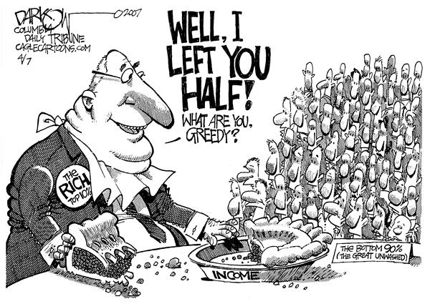
Origin of disparities
Learning Objective: To gain an understanding on how to measure inequality and the differences between regions around the world.
Starter: To what extent do disparities and inequalities occur within countries and how can these be measured?
Challenge: What is the influence on disparities and inequalities of ethnicity, residence, parental education, income, employment and land ownership?

Slide 2
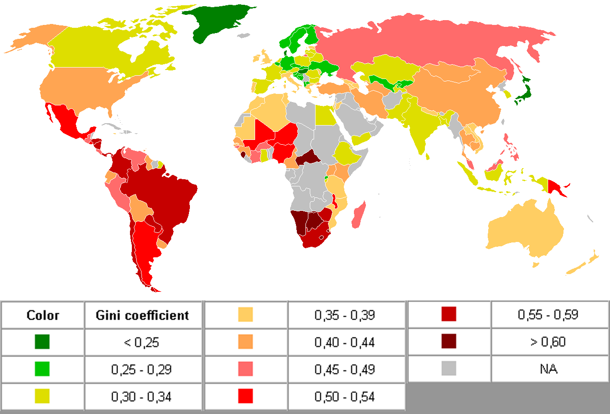
The Gini coefficient
FIG 1.
Demo: Describe the global variation in the Gini coefficient shown in FIG 1.

Slide 3
The Gini coefficient
The Gini coefficient is a commonly-used measure of income inequality that condenses the entire income distribution for a country into a single number between 0 and 1: the higher the number, the greater the degree of income inequality.
The Gini coefficient ranges from zero, when everyone has the same income, to 1, when a single individual receives all the income. A Gini coefficient above 0.4 is often seen as an important point. Inequality above this level is frequently associated with political instability and growing social tensions.

Slide 4

Theory of regional disparities
The Swedish economist Gunnar Myrdal produced his cumulative causation theory in 1957.
The pre industrial stage when regional differences are minimal
A period of rapid economic growth characterised by increasing regional economic divergence
A stage of regional economic convergence when the significant wealth generated in the most affluent region/s spreads to other parts of the country
Demo: Ensure to get a diagram of the cumulative causation theory.

Slide 5
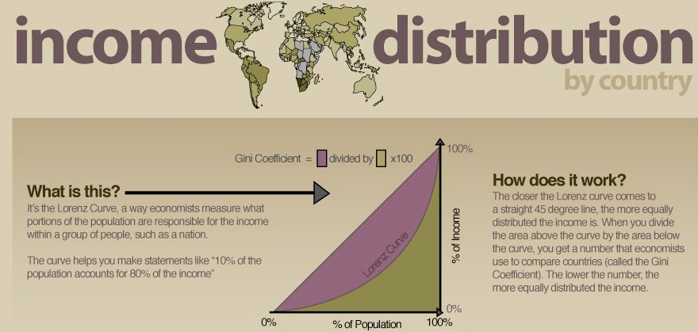
The Lorenz Curve
In economics, the Lorenz curve is a graphical representation of the cumulative distribution function of the empirical probability distribution of wealth or income, and was developed by Max O.Lorenz in 1905 for representing inequality of the wealth distribution.

Slide 6
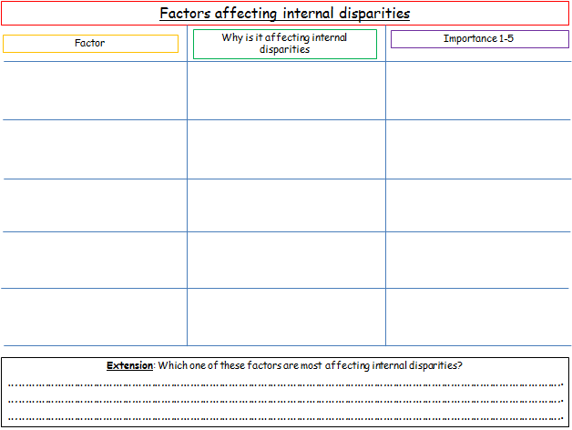
Factors affecting internal disparities
Demo: Read your section and complete the table on your worksheet.
Worksheet
Factors
Residence
Ethnicity and Employment
Education
Land Ownership
Employment

Slide 7
Factors affecting internal disparities
Factor
Why is it affecting internal disparities
Importance 1-5
Extension: Which one of these factors are most affecting internal disparities?
……………………………………………………………………………………………………………………………………………………….
……………………………………………………………………………………………………………………………………………………….
……………………………………………………………………………………………………………………………………………………….

