Slide 1
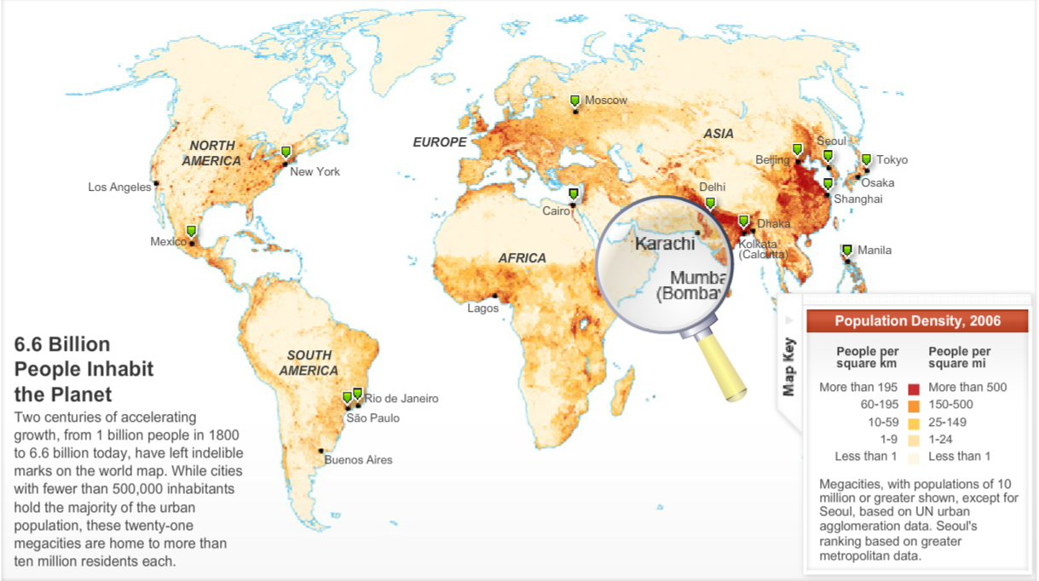
Global Population Density
Population density is the number of people per unit of area, usually quoted per square kilometre or square mile.

Slide 2
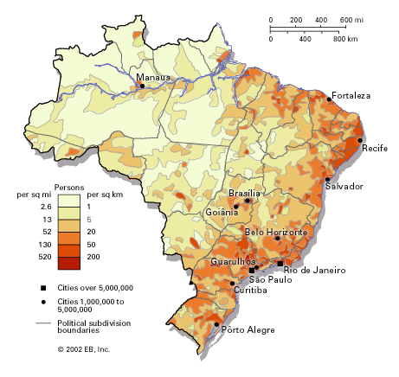
URBANISATION IN BRAZIL - RIO DE JANEIRO
Starter: Look at Source 1 and write a description of the population Density of Brazil. Ensure to use quantification in your answer.
Learning objective: To find out why people move to Rio de Janeiro in huge numbers and the impacts that this has on the megacity.
Urbanisation – the growth in towns and cities.
Megacity- a city that exceed 10 million people.
Densely populated- are areas that have a
high proportion of population.
Sparsely populated- are areas that have a
low proportion of population.
Challenge: What reasons are there as to why Brazil is so divided when looking at population density?
Source 1

Slide 3
URBANISATION IN BRAZIL - RIO DE JANEIRO
Learning objective: To find out why people move to Rio de Janeiro in huge numbers and the impacts that this has on the megacity.
Learning Outcomes:
Settlement: is a place where people live. A settlement may be as small as a single house in a remote area or as a large as a mega city (a city with over 10 million residents). Site: is the actual location of a settlement on the earth and is composed of the physical characteristics of the landscape specific to the area. Site factors include things like landforms (i.e. is the area protected by mountains or is there a natural harbour present?), climate, vegetation types, availability of water, soil quality, minerals, and even wildlife. | Situation: is defined as the location of a place relative to its surroundings and other places. Factors included in an area's situation include the accessibility of the location, the extent of a place's connections with another, and how close an area may be to raw materials if they are not located, specifically on the site. Urban: The built-up area, any city with a population of 10,000 people or more. Rural: Basically the countryside (everywhere outside urban areas). Rural areas maybe farmland, forest, desert or savanna depending on where you are in the world. Rural areas do contain small settlements of less than 10,000 people e.g. hamlets and villages.
All students must know the difference between densely populated and overpopulated. They should be able to annotate the characteristics of a densely populated area (Grade E/D).
Most students should understand the factors leading to an area being densely populated, and that some factors are physical whilst others are human. They should know the issues arising in a densely populated area (Grade C/B).
Some students could apply the points made in the case studies to their own country, and use these in new examples given to them (Grade A/A*).

Slide 4
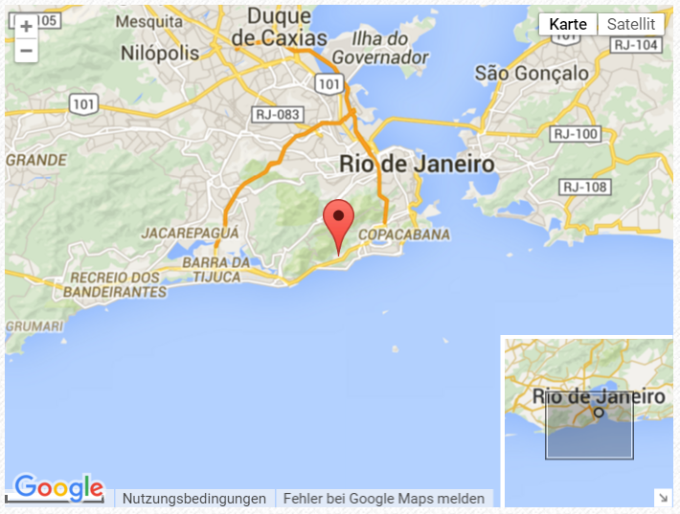

URBANISATION IN BRAZIL - RIO DE JANEIRO
Demo: Ensure to write a quick paragraph on the location of Rio de Janeiro.
N
W
E
Urban population: 85.7% of total population (2015)
Rio de Janeiro 12.902 million
Net migration rate:
-0.14 migrant(s)/1,000 population (2015 est.)
S

Slide 5
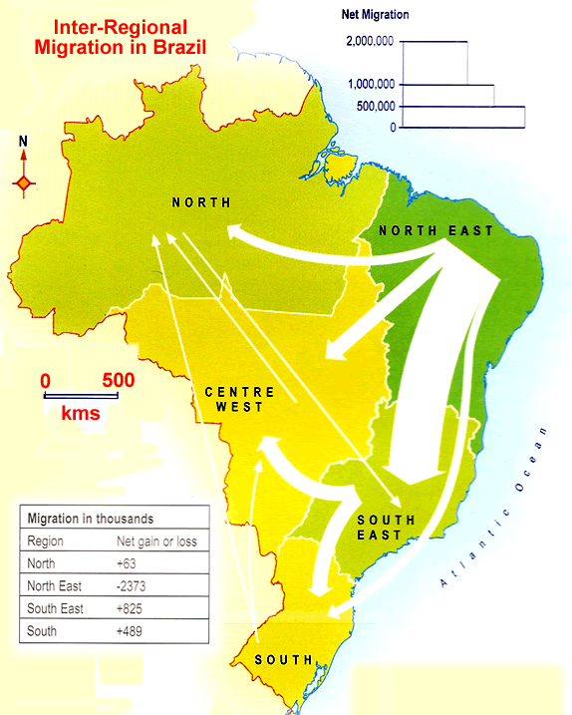
INTERNAL MIGRATION
BRAZIL
Demo: Ensure to add the migration information to your map.

Slide 6
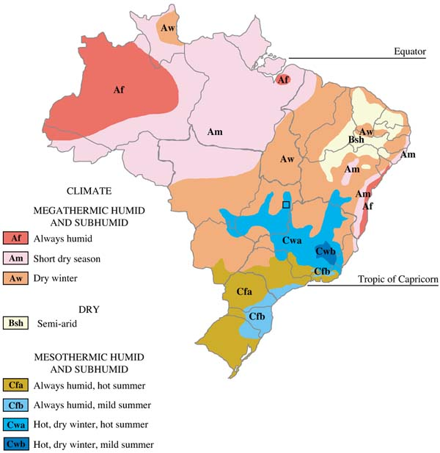
Brazil Climate Map

Slide 7
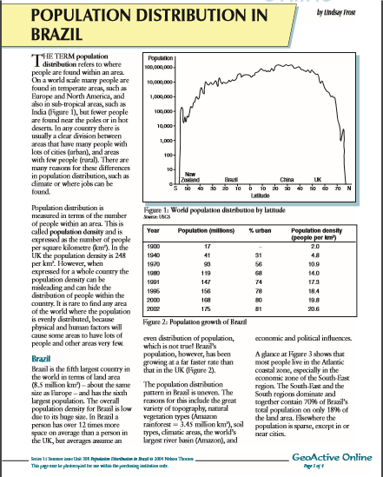
URBANISATION IN BRAZIL - RIO DE JANEIROc
Demo: Read through your GeoActive sheet and add any reasons to your spider diagram as to why Rio may be so densely populated.
Effect:
Cause:
Challenge: Divide your spider diagram into causes and effects.
Notes:
Urbanisation can cause problems such as transport congestion, lack of sufficient housing, over-rapid growth and environmental degradation. Many cities display particularly sharp inequalities in housing provision, health and employment. Some people try to escape these problems by moving away from the city - a process called counter-urbanisation. Long term, however, the solution must be to make cities more sustainable. Causes of urbanisation Urbanisation means an increase in the proportion of people living in urban areas compared to rural areas. An urban area is a built-up area such as a town or city. A rural area is an area of countryside. As a country industrialises, the number of people living in urban areas tends to increase. The UK and many other MEDCs urbanised during the 18th and 19th centuries. People migrated from rural areas (due to the mechanisation in farming) to urban areas where there was employment in the new factories. The area of cities known as the inner city developed during this time as rows of terraced housing were built for workers.
7

Slide 8


Plenary
Learning objective: To find out why people move to Rio de Janeiro in huge numbers and the impacts that this has on the megacity.
Homework
Plenary: Please take the time to watch the Video at home about the Favela’s Spend 24 minutes watching the documentary to the right on YouTube. Take notes on the key aspects of the Favela Clearance Programme in Rio.

