Slide 1
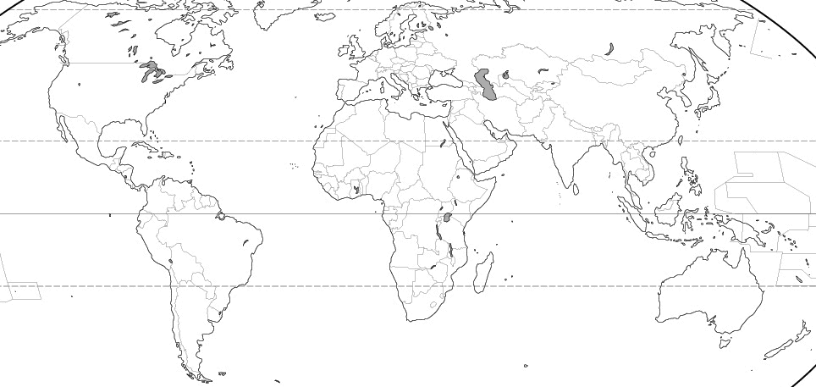
Starter: My Connections
KEY:
Migrated from
Tourist in
Birthplace/Where are your parents/grandparents from?/ If you have relatives abroad where do they live?/ Where is the furthest you have been on holiday?

Slide 2
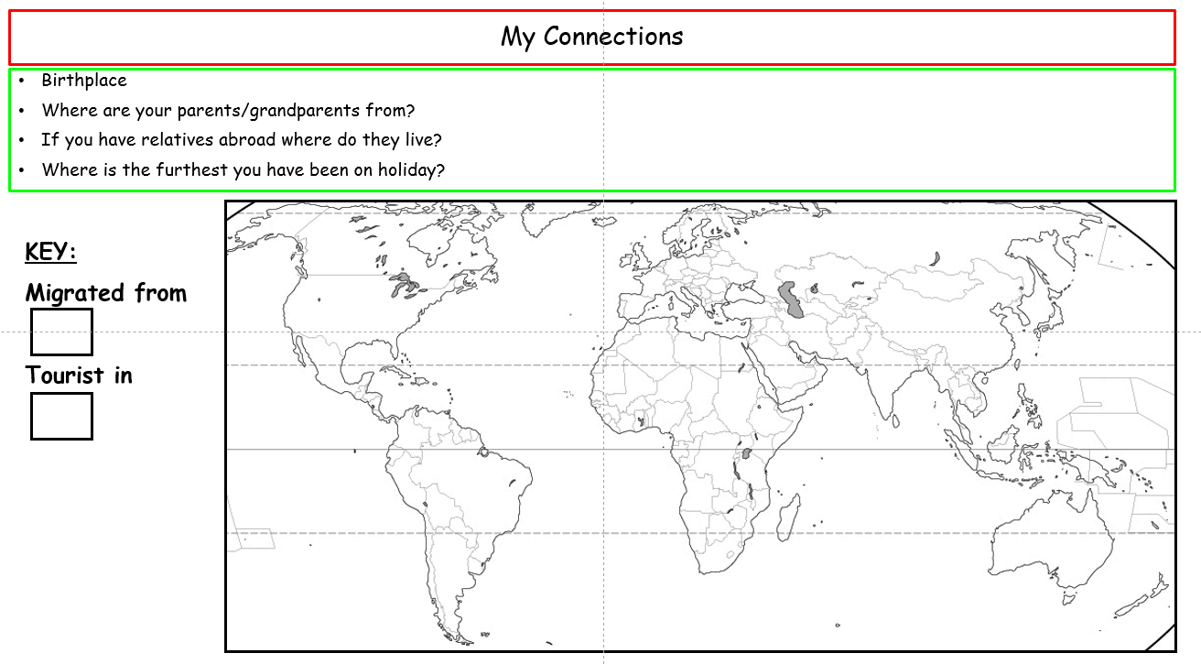
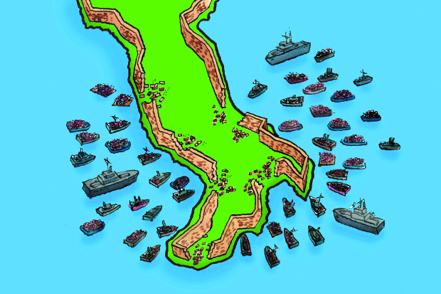
Migration
Learning Objective: To explain and give a range of reasons as to why people migrate, ensuring to use geographical models to explain why people move.
Starter: Complete your starter sheet.
Key Language:
Migration is the movement of people across a specified boundary, national or international, to establish a new permanent place of residence.
Challenge: What issue is being portrayed in Source A?

Slide 3
Glossary
Migration: a movement of people from a source area to a receiving area
Emigrants: people who move from or out of an area
Immigrants: people who move into an area
Refugees: People who are forced to migrate owing to a well founded fear of being persecuted for reasons of race, religion, nationality, membership of a particular social group or opinion
Push Factor: those which encourage people to leave the source area
Pull Factors: those that attract people to go to the receiving area.

Slide 4
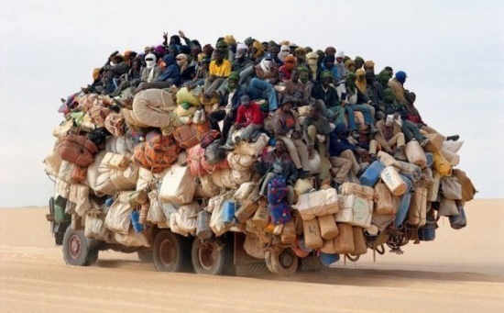


Reasons for Migration
Demo: Why might people decide to migrate? List below the reasons as to why people decide to migrate.
Push
Pull
Push Factors: Things people don’t like that make them want to leave an area
Pull Factors: Things people like that make them want to move to an area.
Challenge: Can these be categorized?

Slide 5
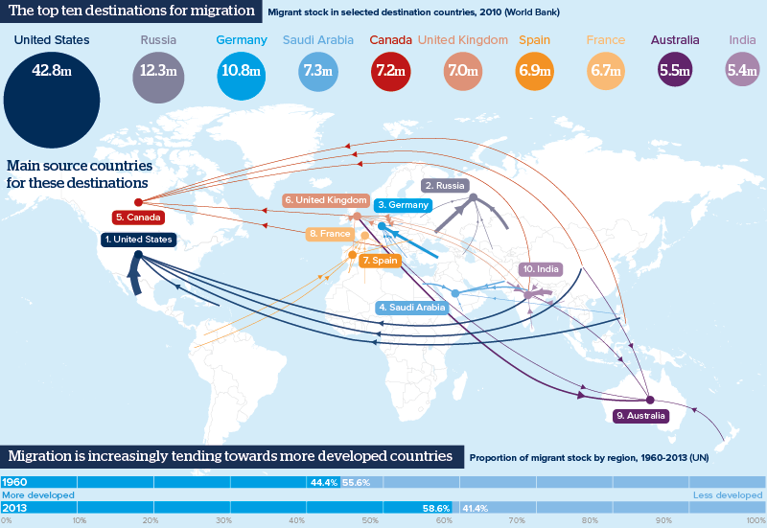
Measuring Migration
Demo: Look at Source B and describe the main global pattern of migration.
Source B

Slide 6
Migration
What are the causes of migration, both forced and voluntary?
What are the geographical impacts of internal migration at their origins and destinations?
What are the geographical impacts of international migrations?
Key Language
Voluntary migration: They have a free choice as to whether to move or not
Push factors: Negative conditions at the point of origin which encourage or force people to move.
Forced migration: individuals have little choice or no choice but to move.
Pull factors: Positive conditions at the point of destination which encourage people to move.
Migration: the movement of people across a specified boundary, national or international, to establish a new permanent place of residence. Lasting for more than 1 year (UN)
Remittances: money sent back by migrants to their family in the home community.

Slide 7
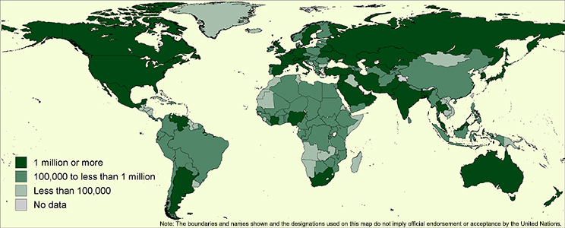
Migration Trends
Demo: What is the Global distribution of International Migration.
Demo: What is the Global distribution of International Migration.

Slide 8
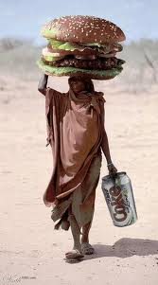
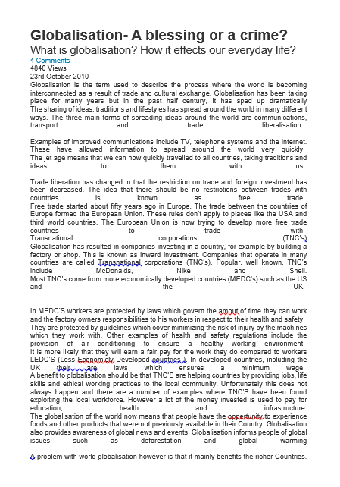
General Migration Trends
Demo: Look at the statements below. Use some of the linking language to the right to provide an explanation as to why this is occurring.
Migration has become circular in nature,………………………………………………………………………………………….
Their has been an increase in migration destination,…………………………………………………………………………………………….
The proportion of female migrants has increased………………………………………………………………………………………………….
People aren’t just moving from developing to developed countries,…………………………………………………………………….
Therefore
This means
Because
Why?
Globalisation: the increasing interconnectedness and interdependence of the world economically, culturally and politically.
Challenge: Read the Article that you have been given and formulate an opinion on the debate.

Slide 9
Good Impacts of Migration Bad
Demo: Copy the chart below and fill in the table.
Hint: If you are struggling turn to pages 23/24 in your Books.
±
What are…..
±
What are…..
±
What are…..
Impacts of Migration of Origin
Impacts of Migration of Destination
Impact on migrants themselves
Remittances: Money sent back to their families in their home communities by migrants. ($400 Billion in 2012)
Increase in Workforce
Great wage general improvement in the quality of life.
Limits wage rises(lowers Inflation)
Helps them provide financial support to their families.
Cultural Diversity
Reducing population pressure
Reduce Population Ageing
Developing language skills
Lowering levels of unemployment
Reduce pressure on services
-
-
Help develop new skills.
Put pressure on infrastructure
Financial cost of migration may be significant
-
Competition for workplaces
Separation from family
Loss of workers “Brain Drain”
Ethnic imbalance
Culture shock
Loss of Farmers means loss of Crops
Legal and other issues
Risk of exploitation.
Gender Imbalance

